Slide 1
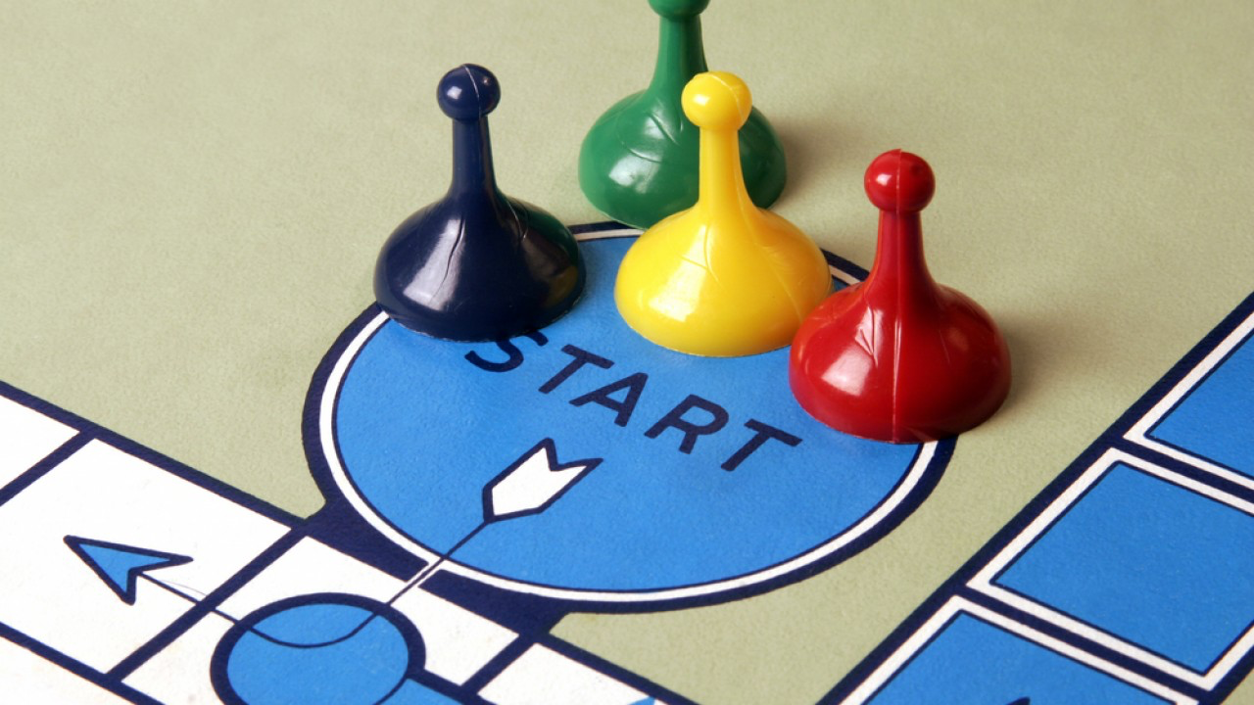
How to gamify your English class
Elena Peresada

Slide 2
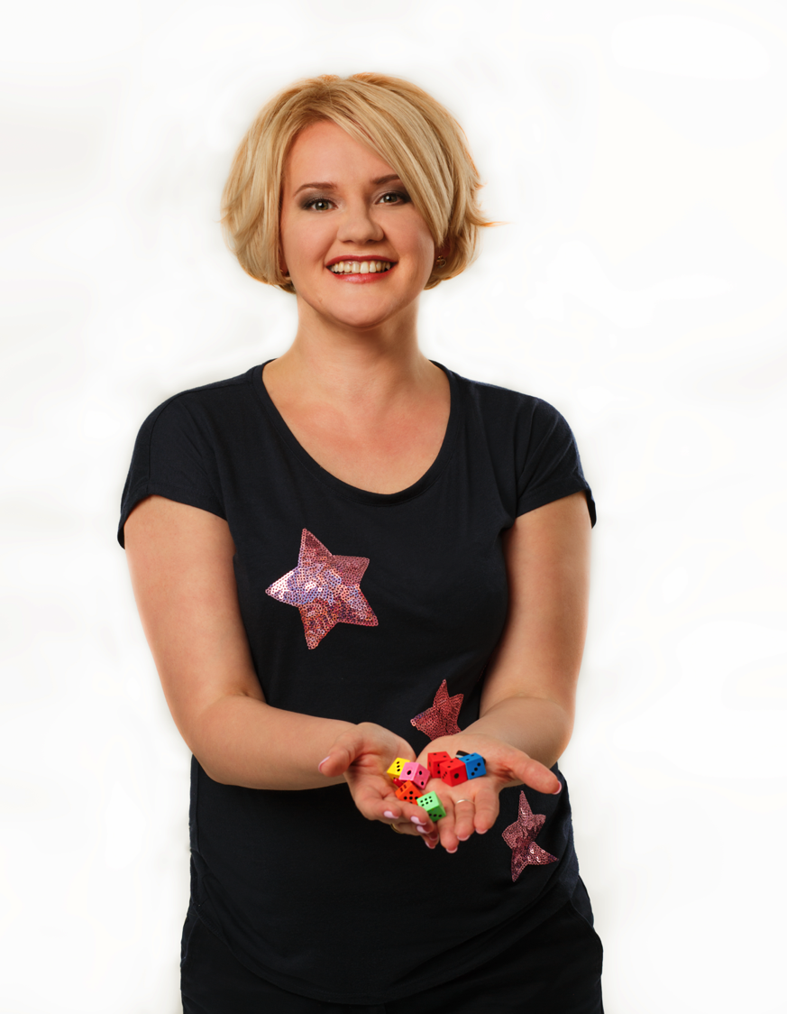


Elena Peresada,
game educator

Slide 3
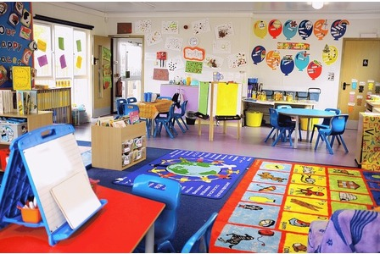

Slide 4


Slide 5
I don’t play a lot of games because
Students don’t like games, they’re too old to play
I don’t have time to play games

Slide 6
What are your favourite games?

Slide 7
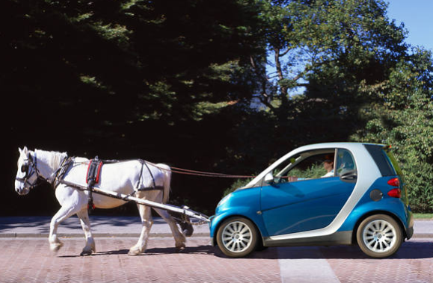
Игры в ELT

Slide 8
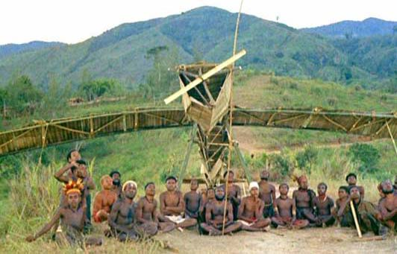
C
Cargo Cult

Slide 9
Что такое игра?

Slide 10
Цель (игрока, игры, педагога)
Правила
Награда
Попытки
Агенты

Slide 11

Брокколи в шоколаде

Slide 12
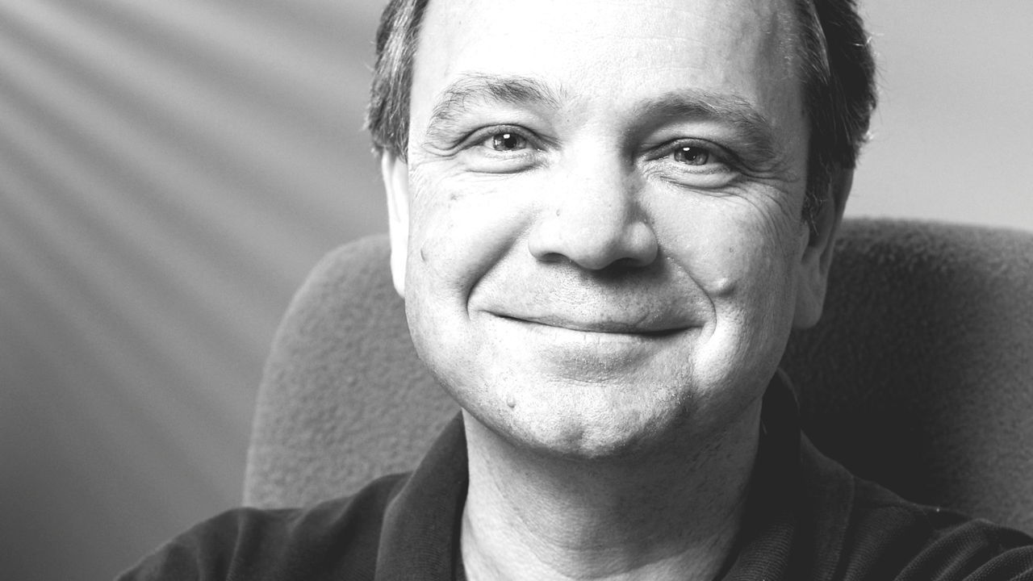
“Игра – это последовательность интересных выборов,”
Sid Meier

Slide 13
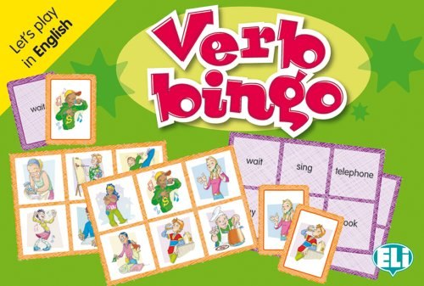
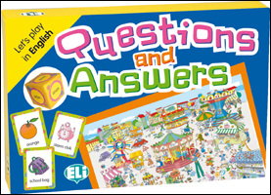
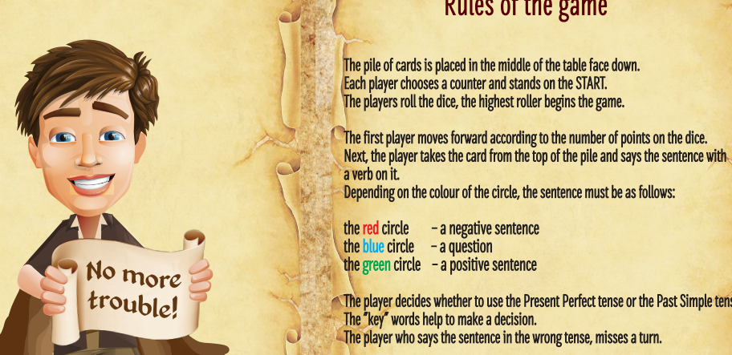
Это игры?

Slide 14
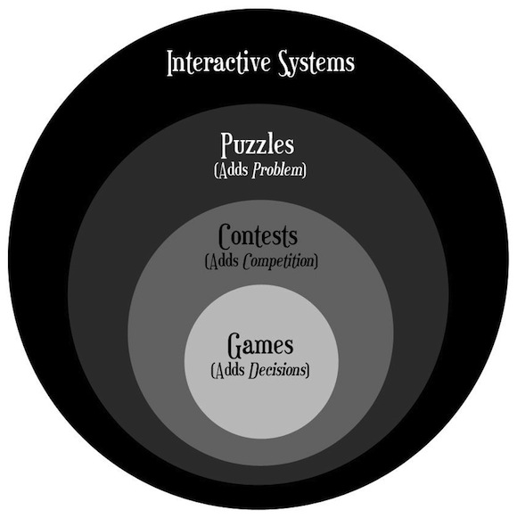

Slide 15
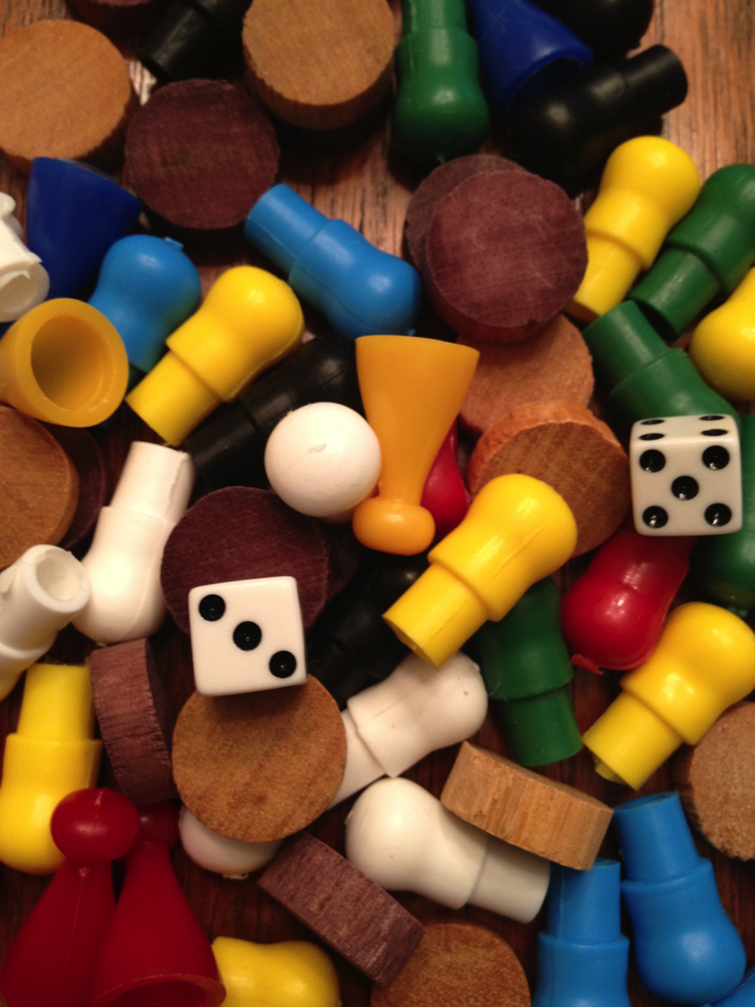
Game mechanics
Loss aversion
Acting
Memory
Dice rolling
Coundown
Player elimination
Set collection

Slide 16
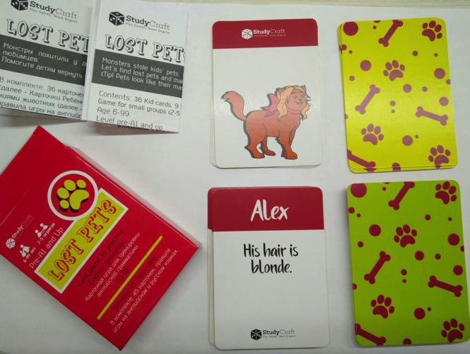
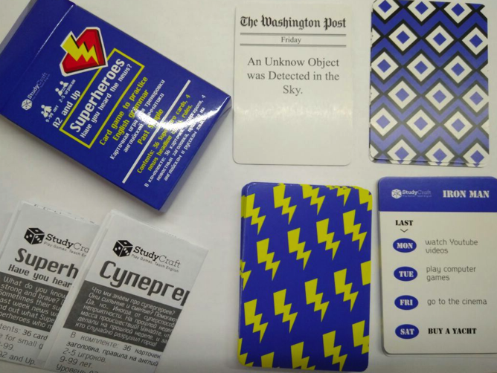
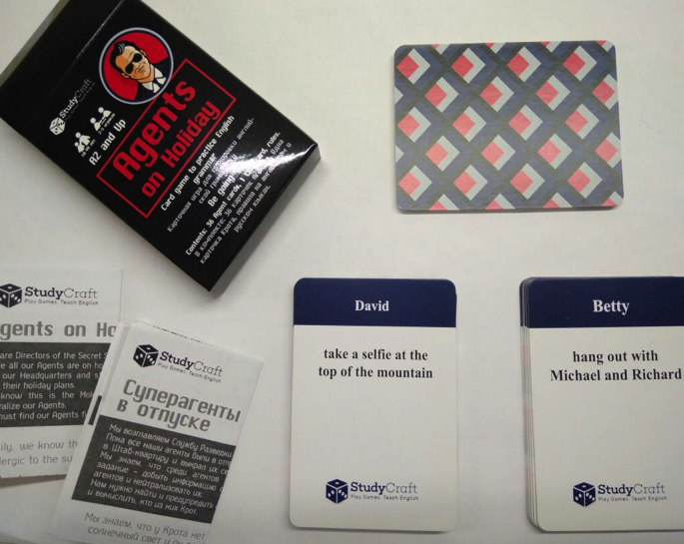
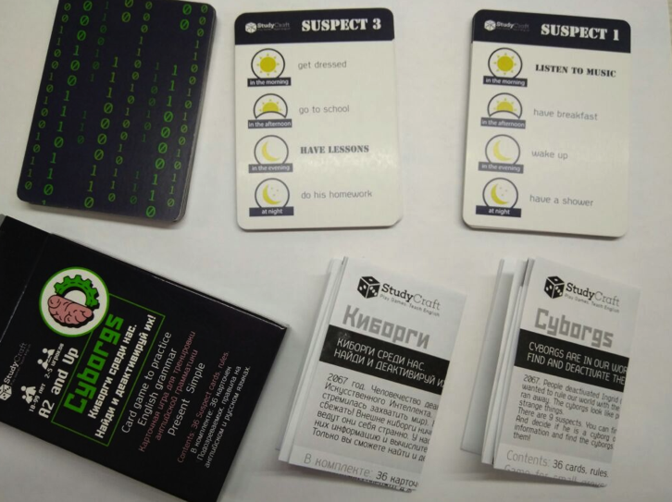

Slide 17
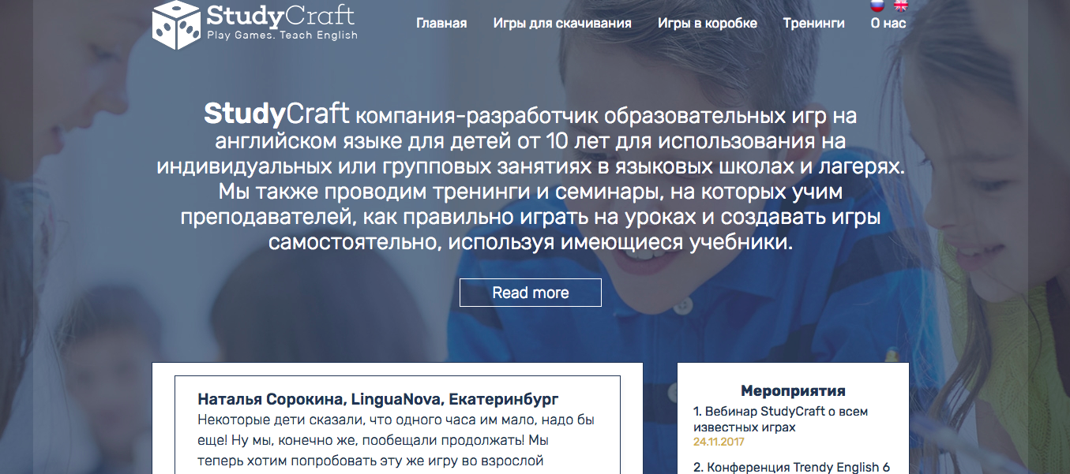
studycraft.ru

Slide 18
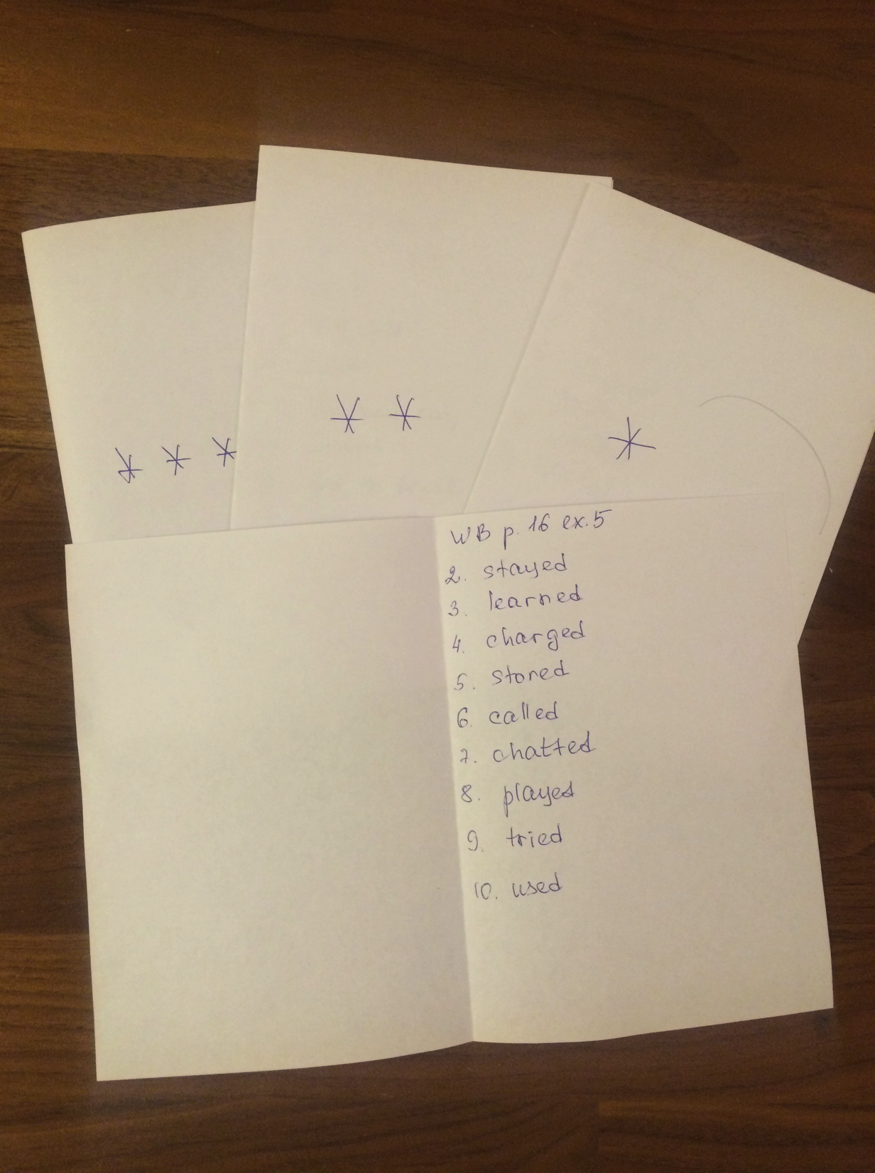

Slide 19
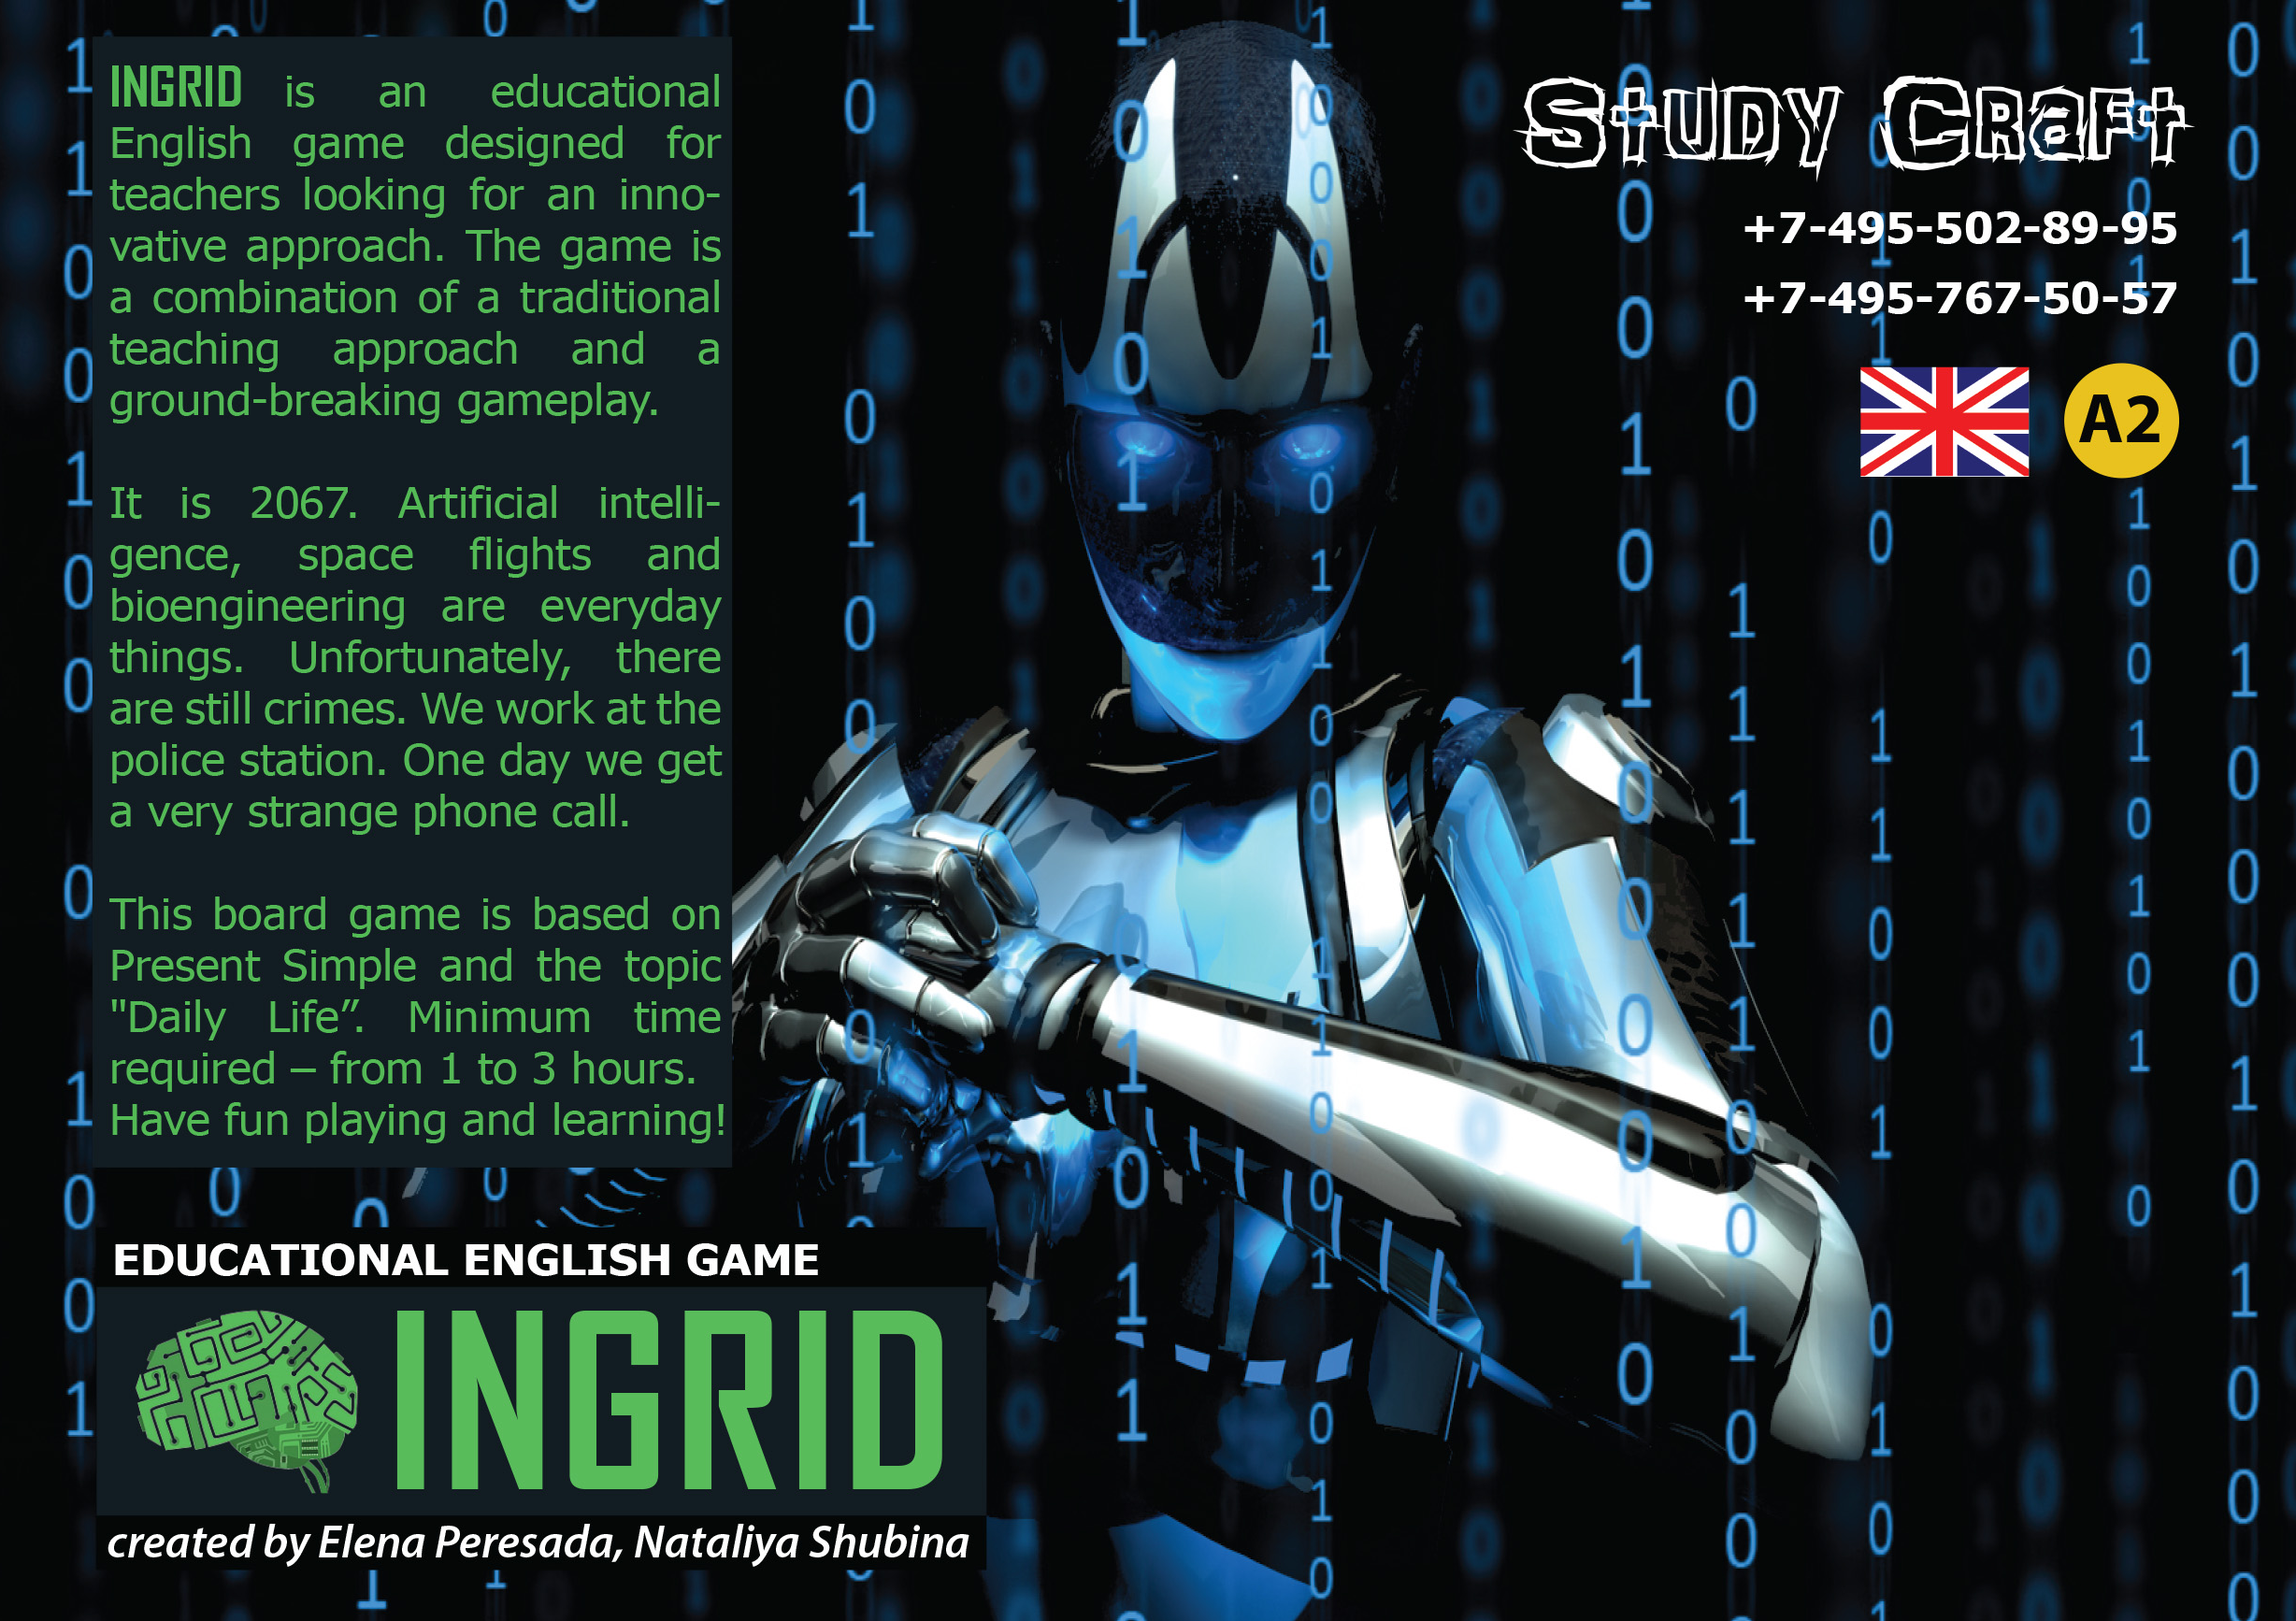

Slide 20
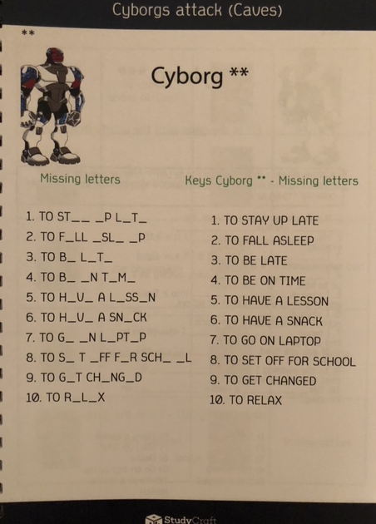
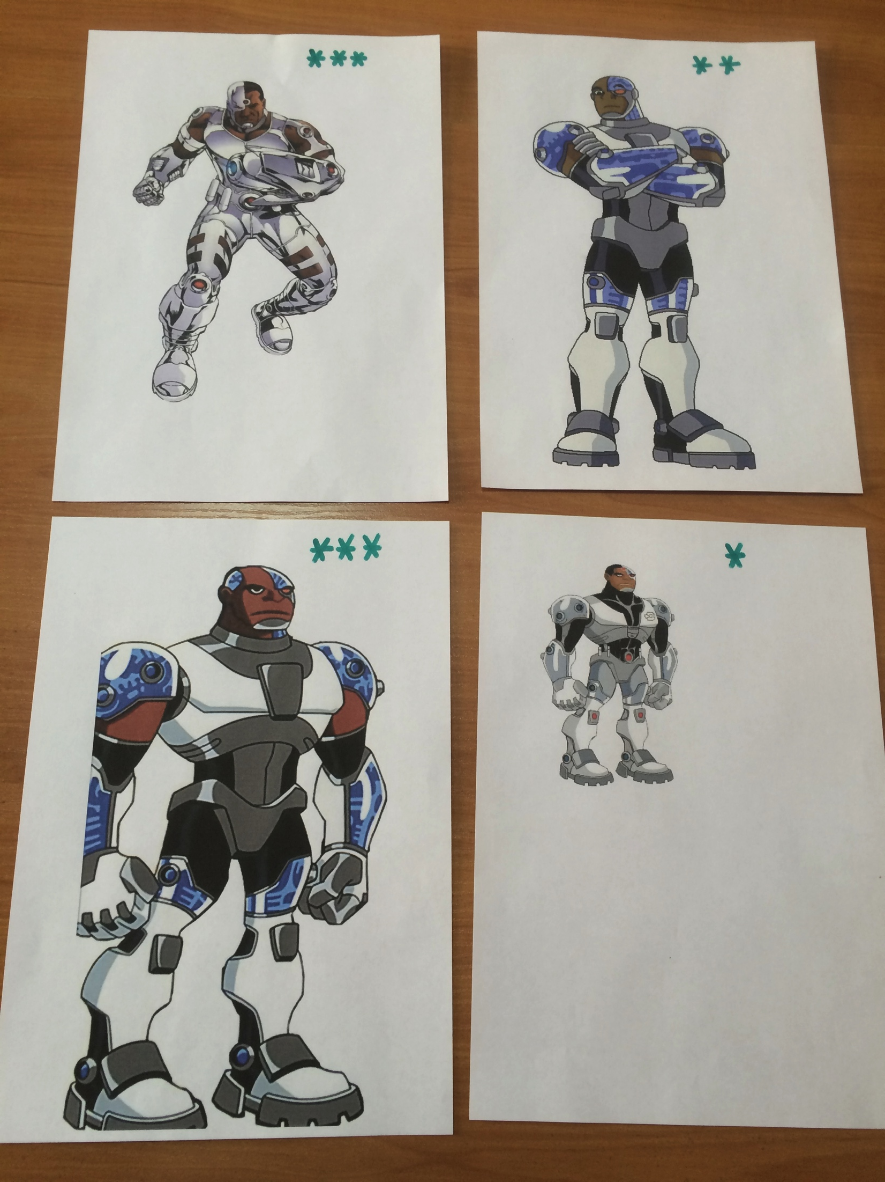

Slide 21
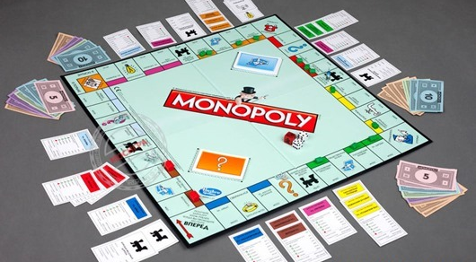
Антуражность

Slide 22
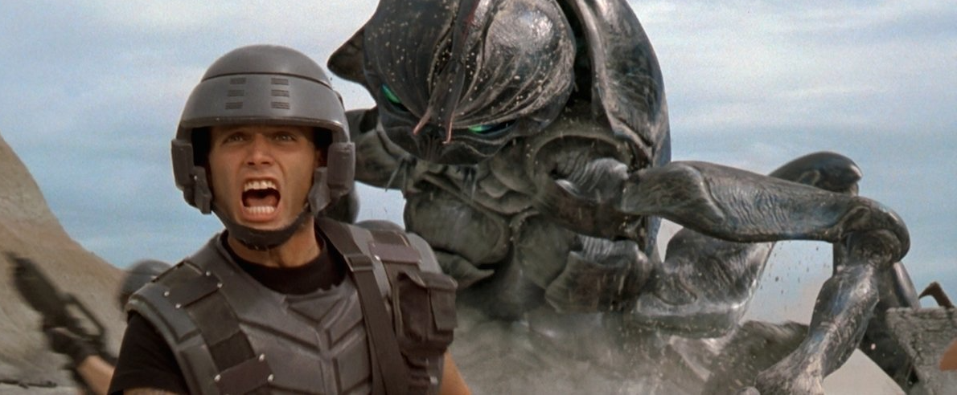
Starship troopers

Slide 23
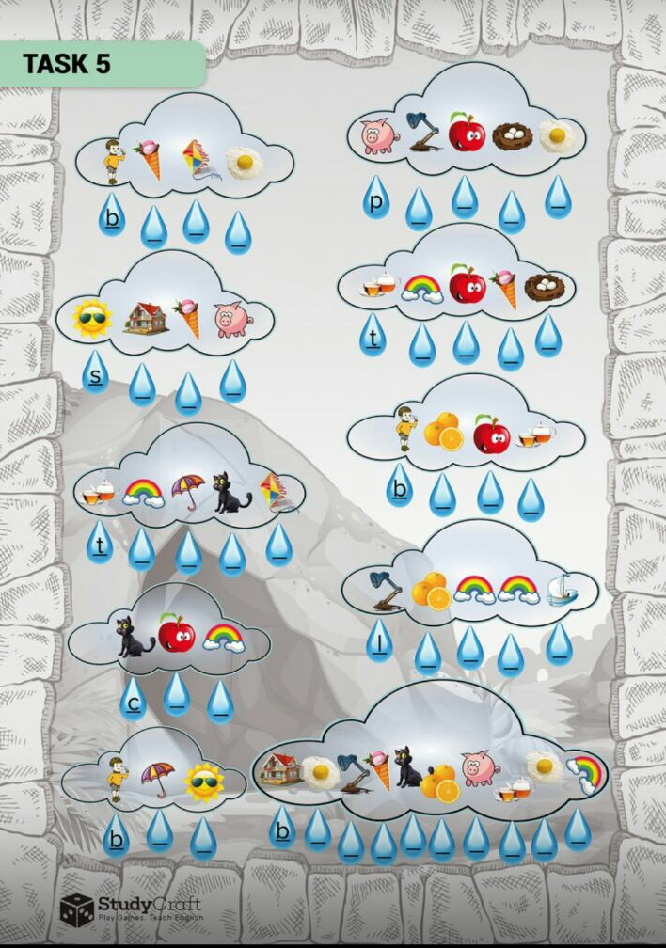
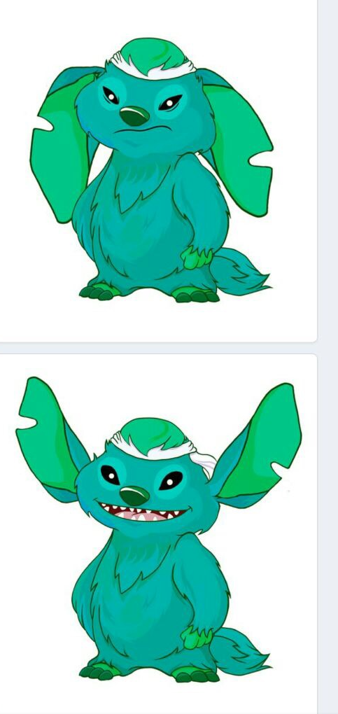

Slide 24
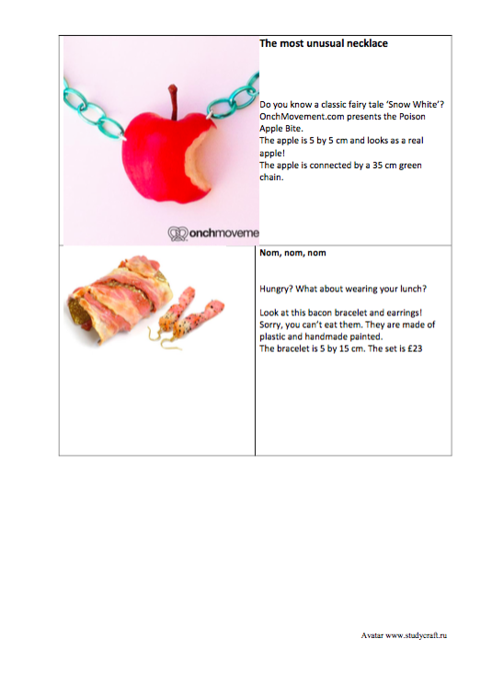
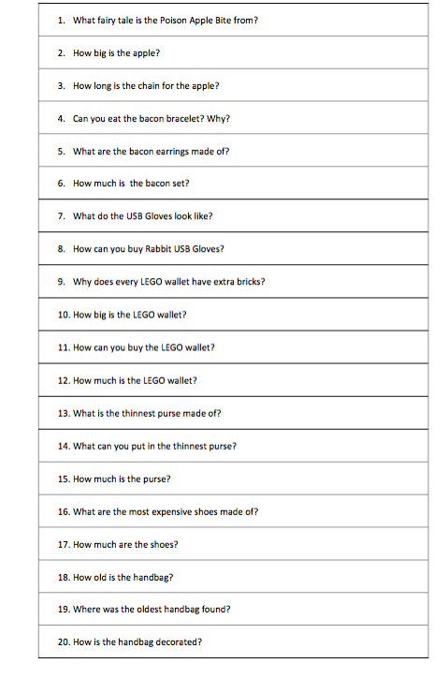

Slide 25
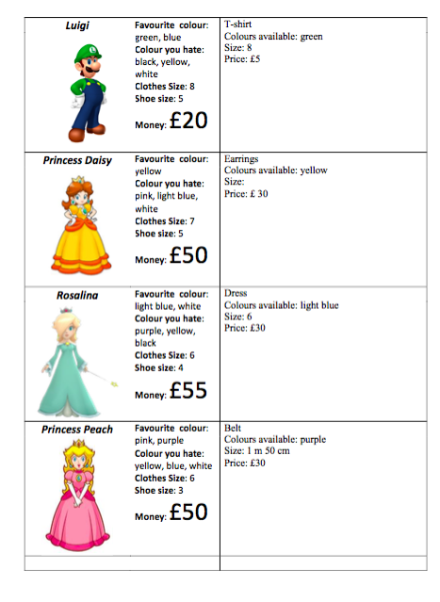
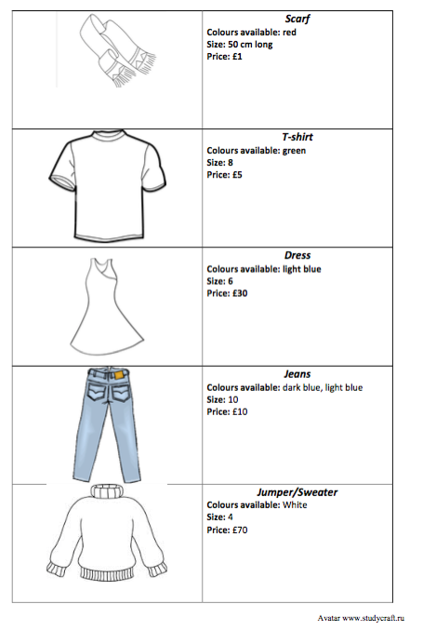

Slide 27
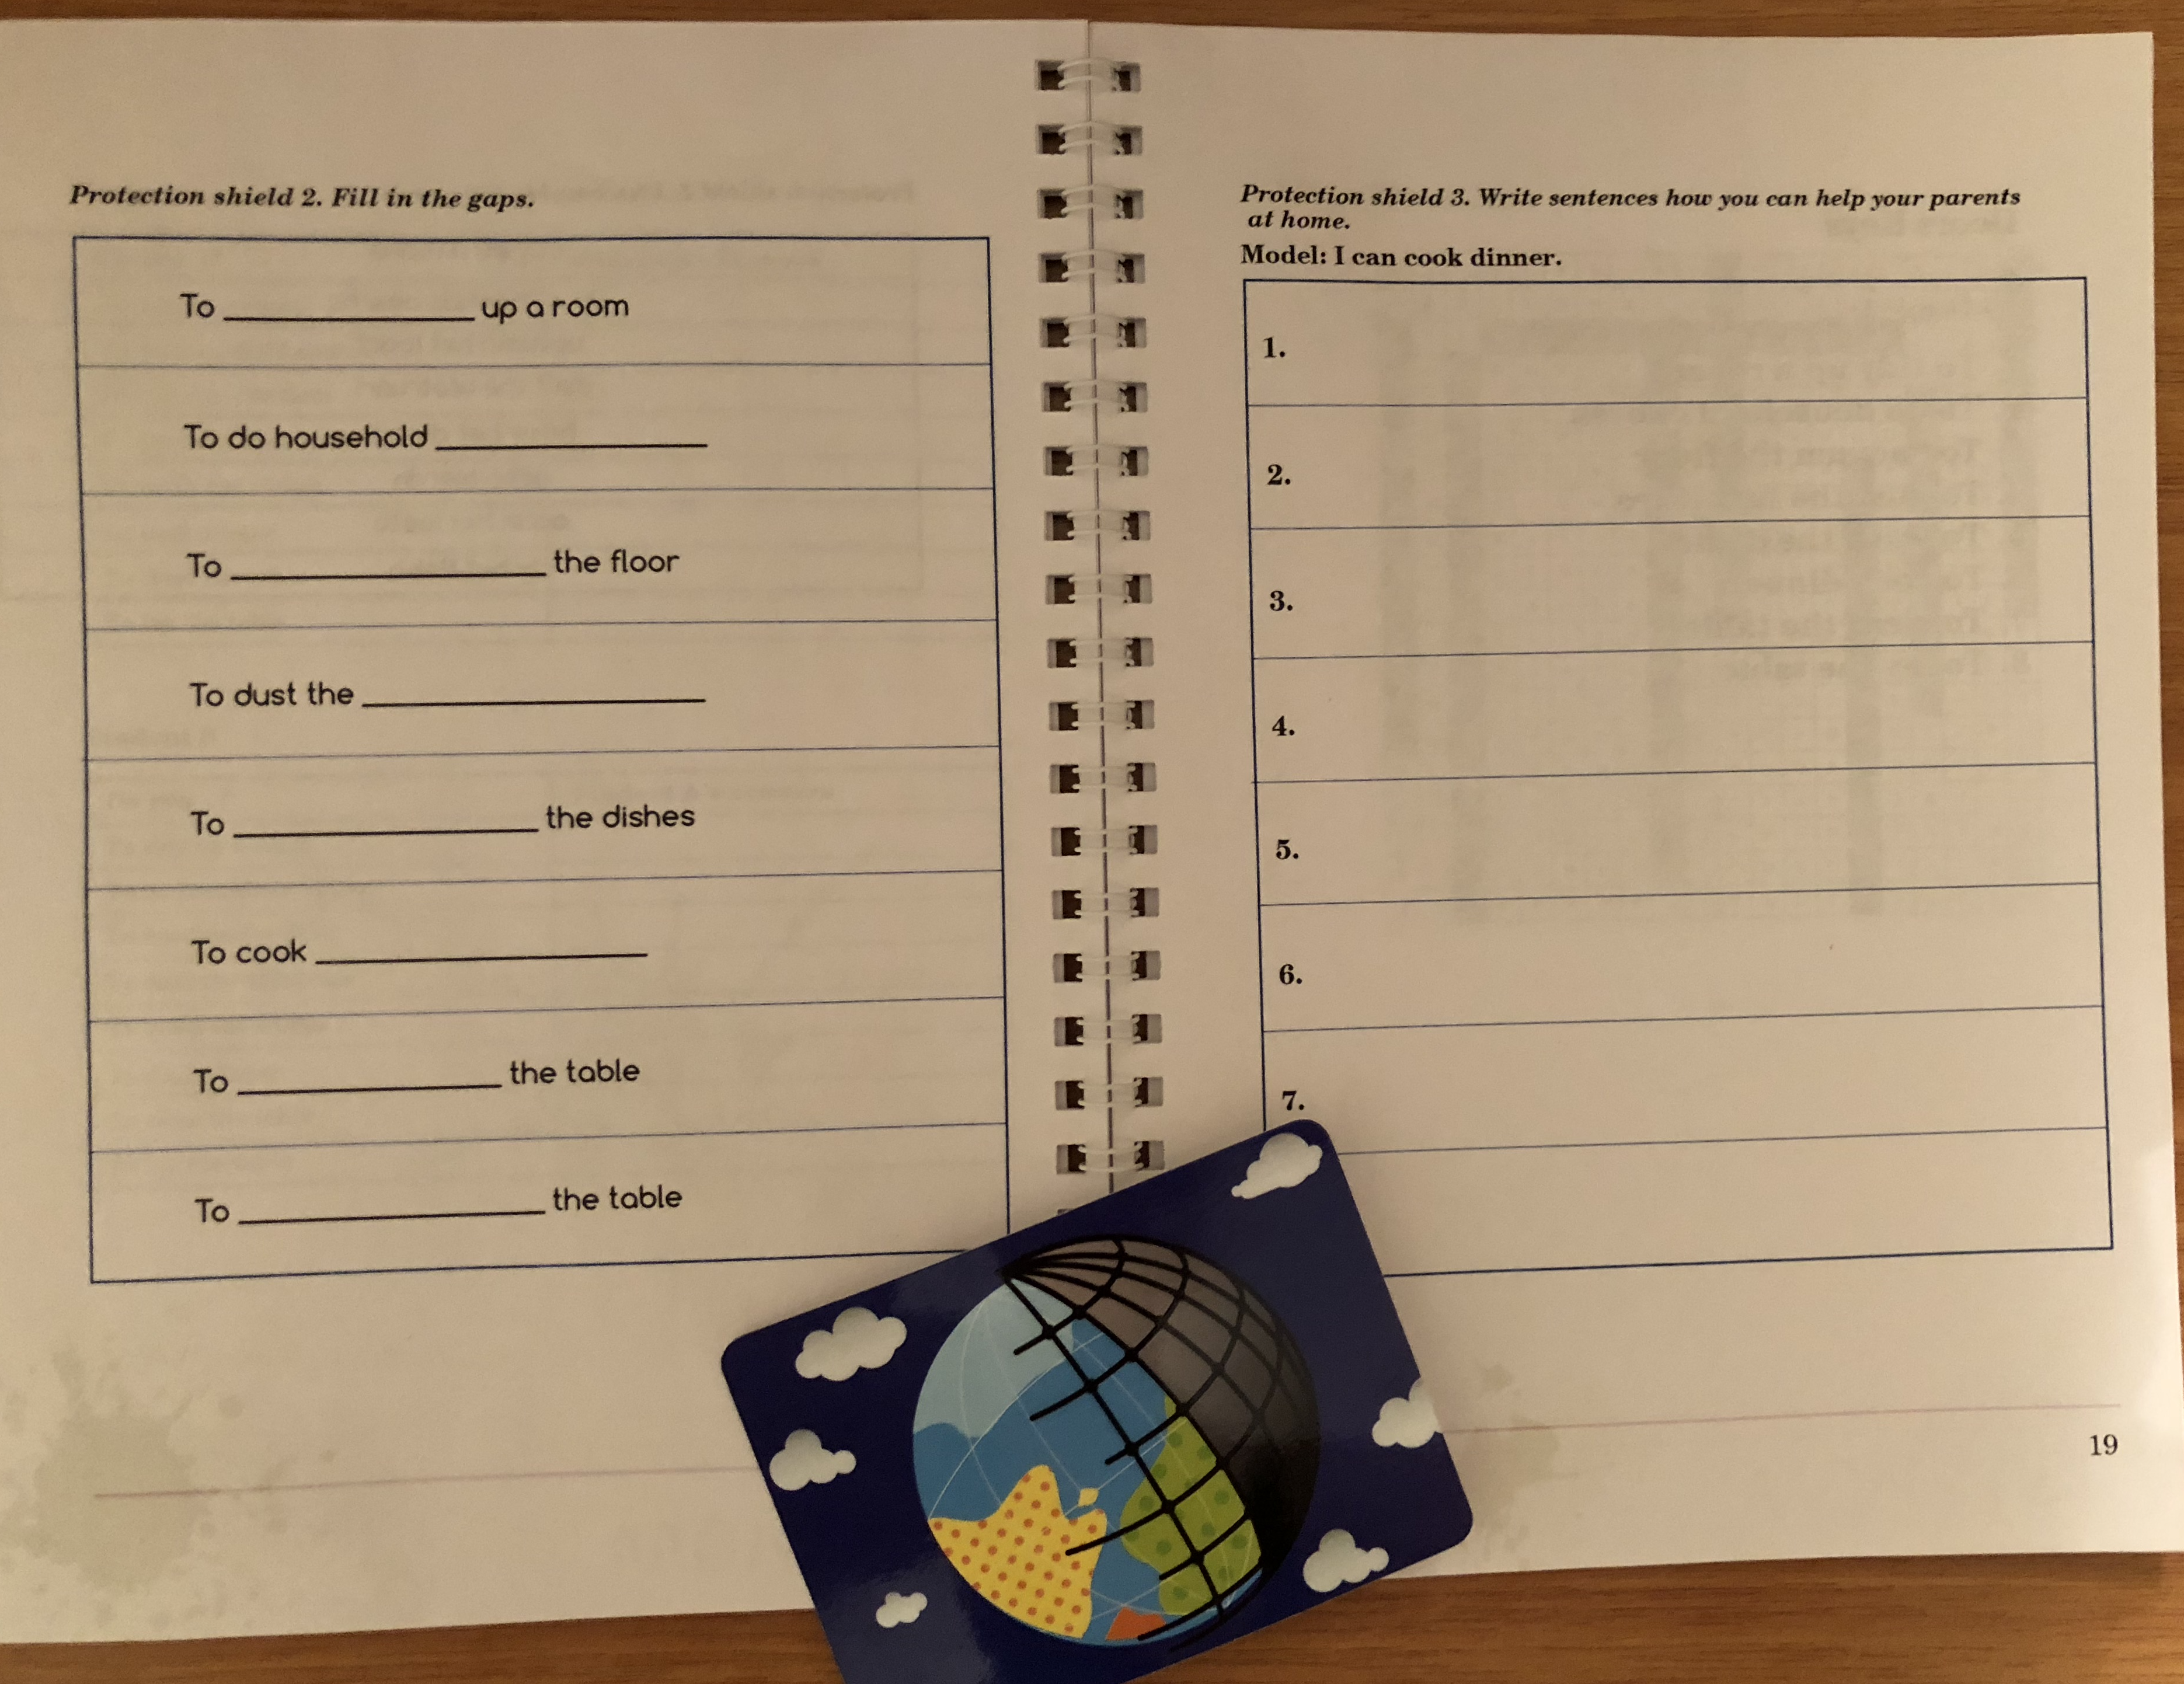

Slide 28
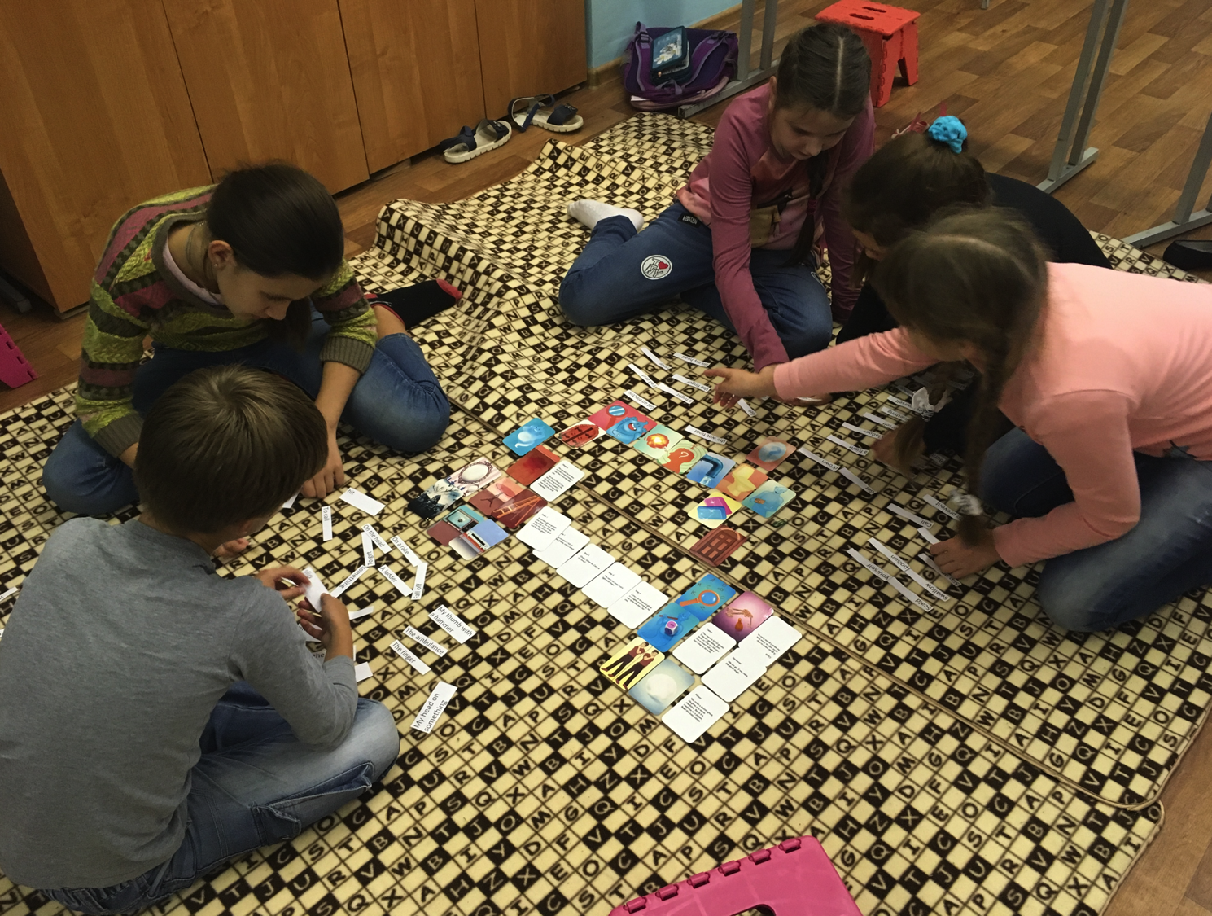

Slide 29
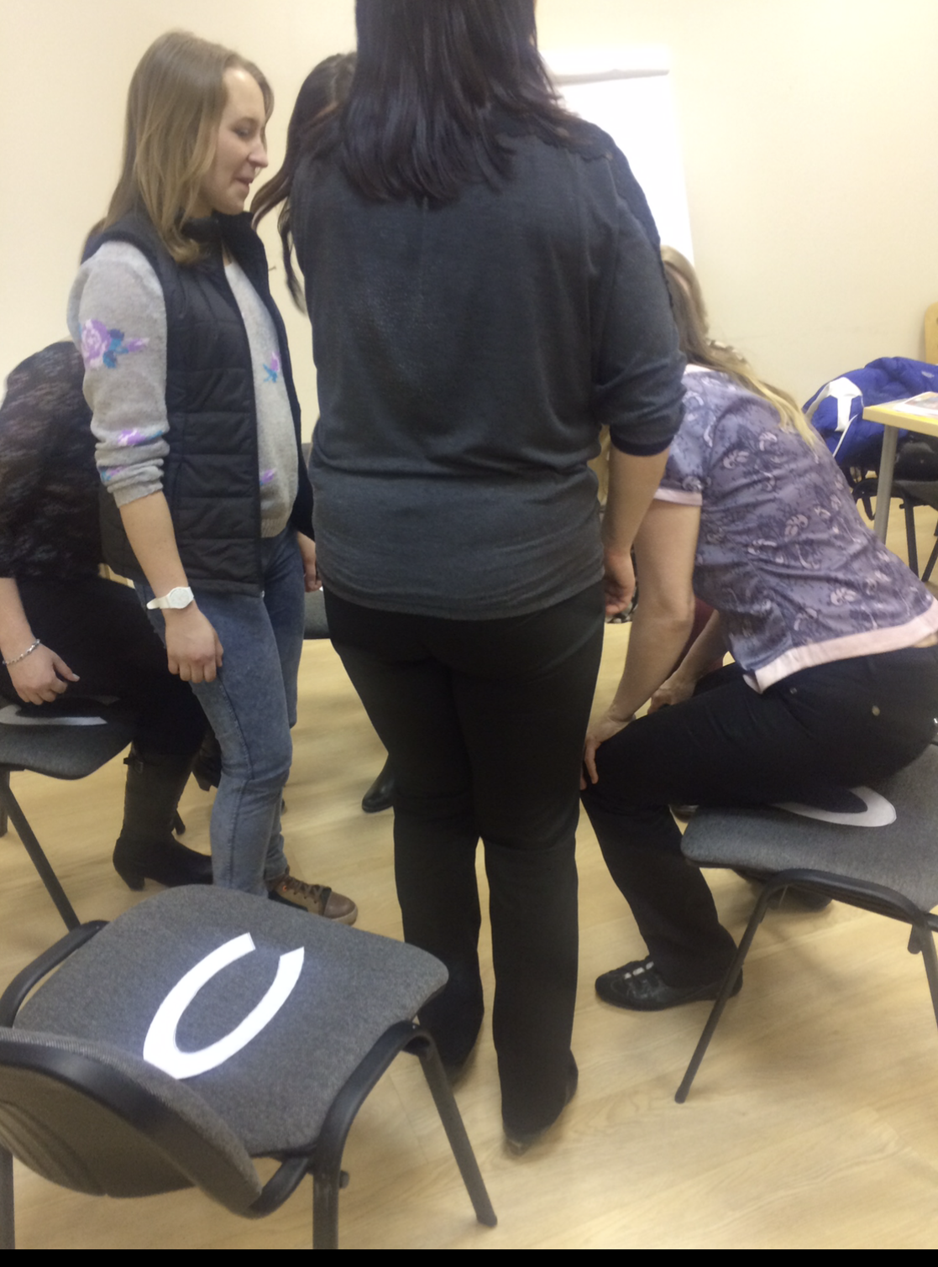
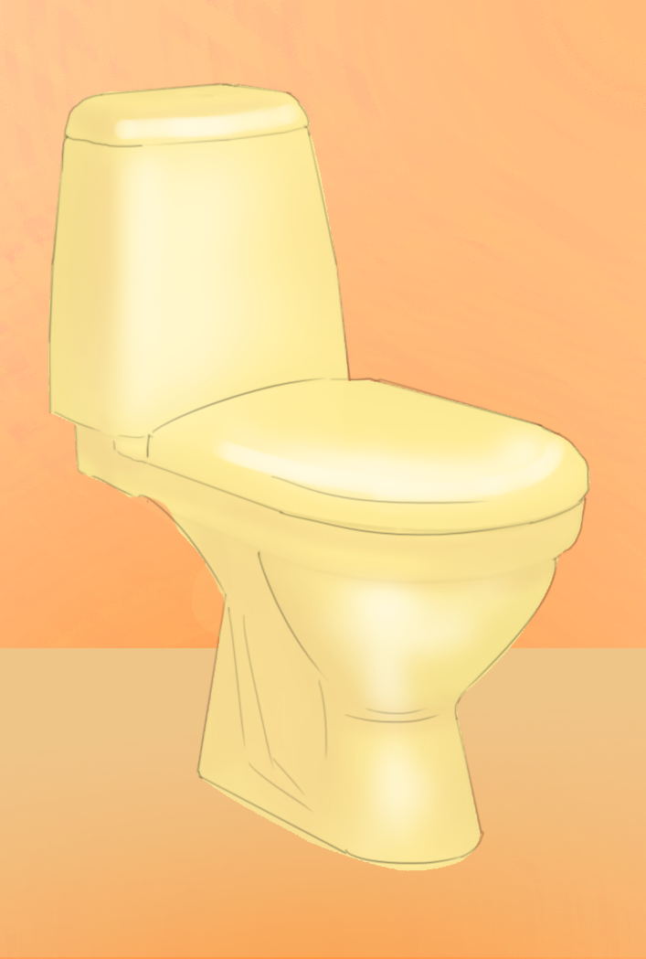

Slide 30


Slide 31


Slide 32
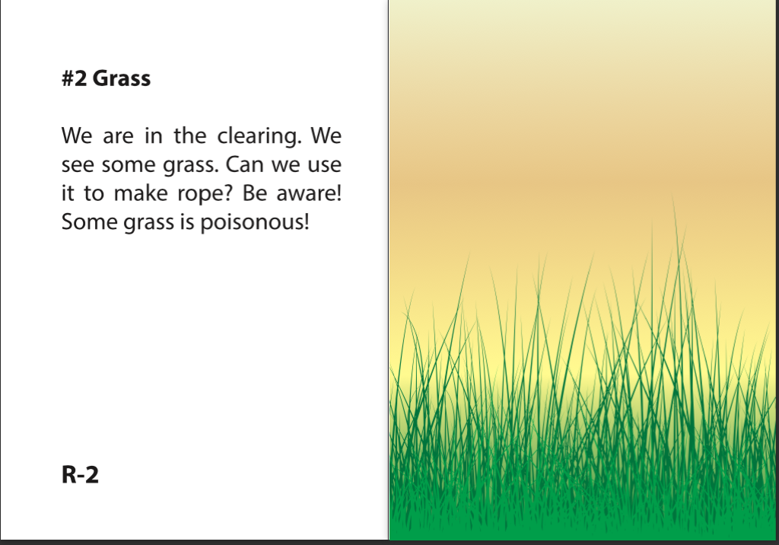

Slide 33
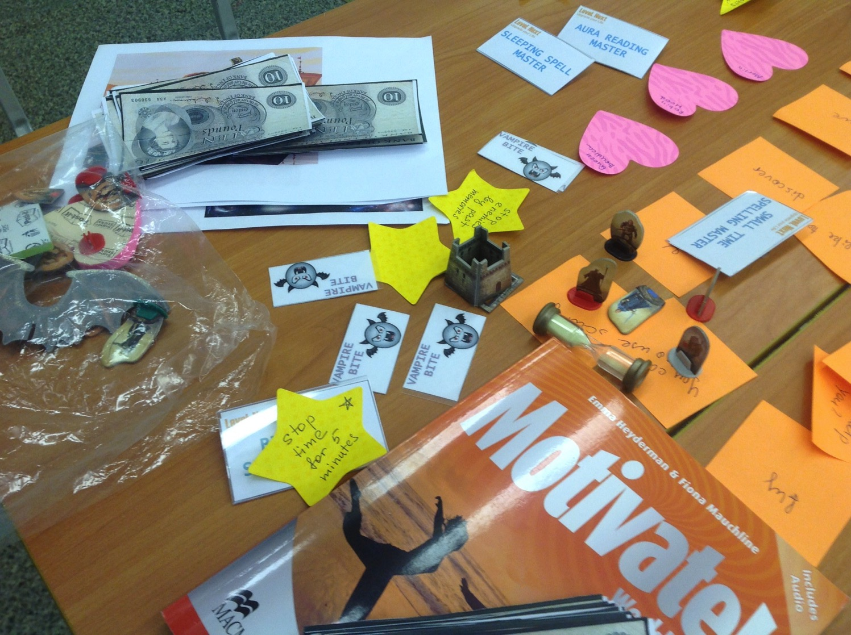
Role
play
game

Slide 34
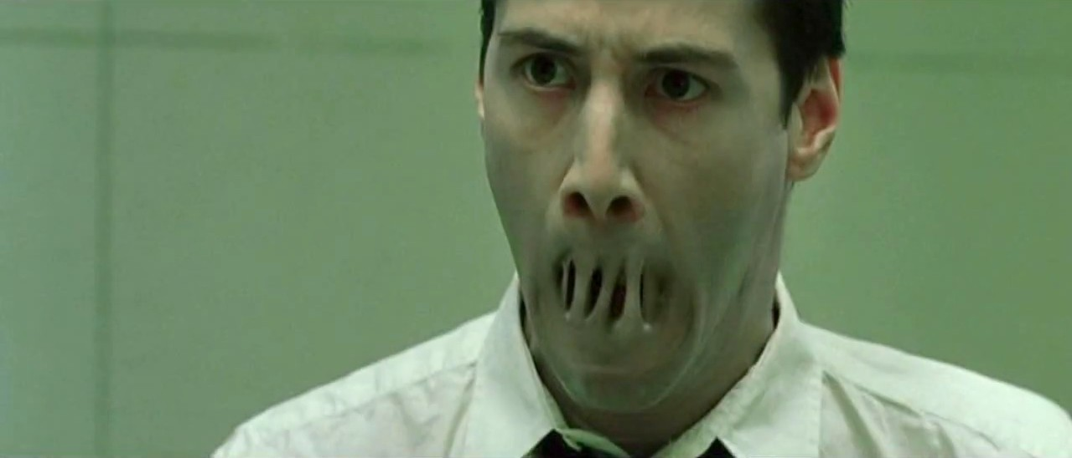
Breaking language barrier

Slide 35
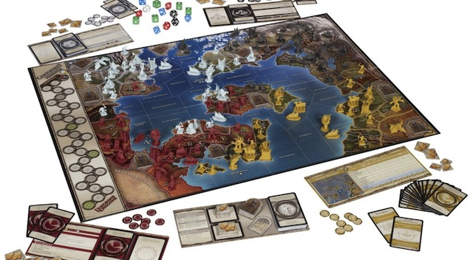
Dungeon and Dragons 1974

Slide 36
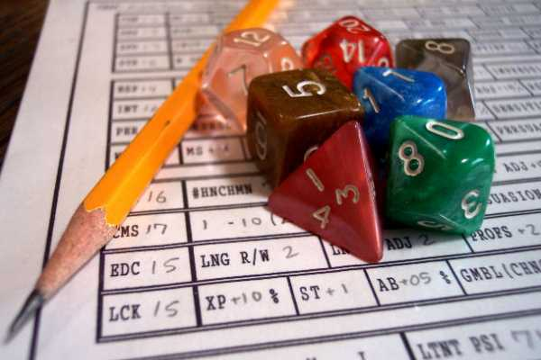
RPG
interactive stories
basic plot elements
narratives through actions

Slide 37
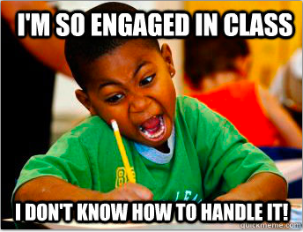
RPGs Benefits
Real use of the language
Emotionally charged
Positive effect on student socialization skills
http://interactivedramas.info/papers/phillipsrpgclass.pdf

Slide 38
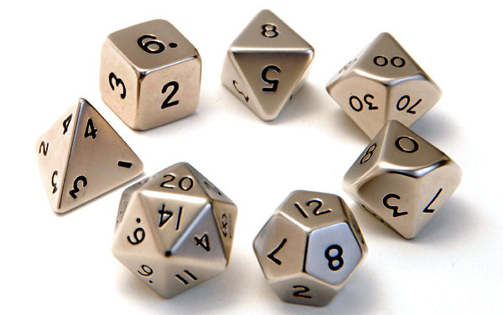

Slide 39
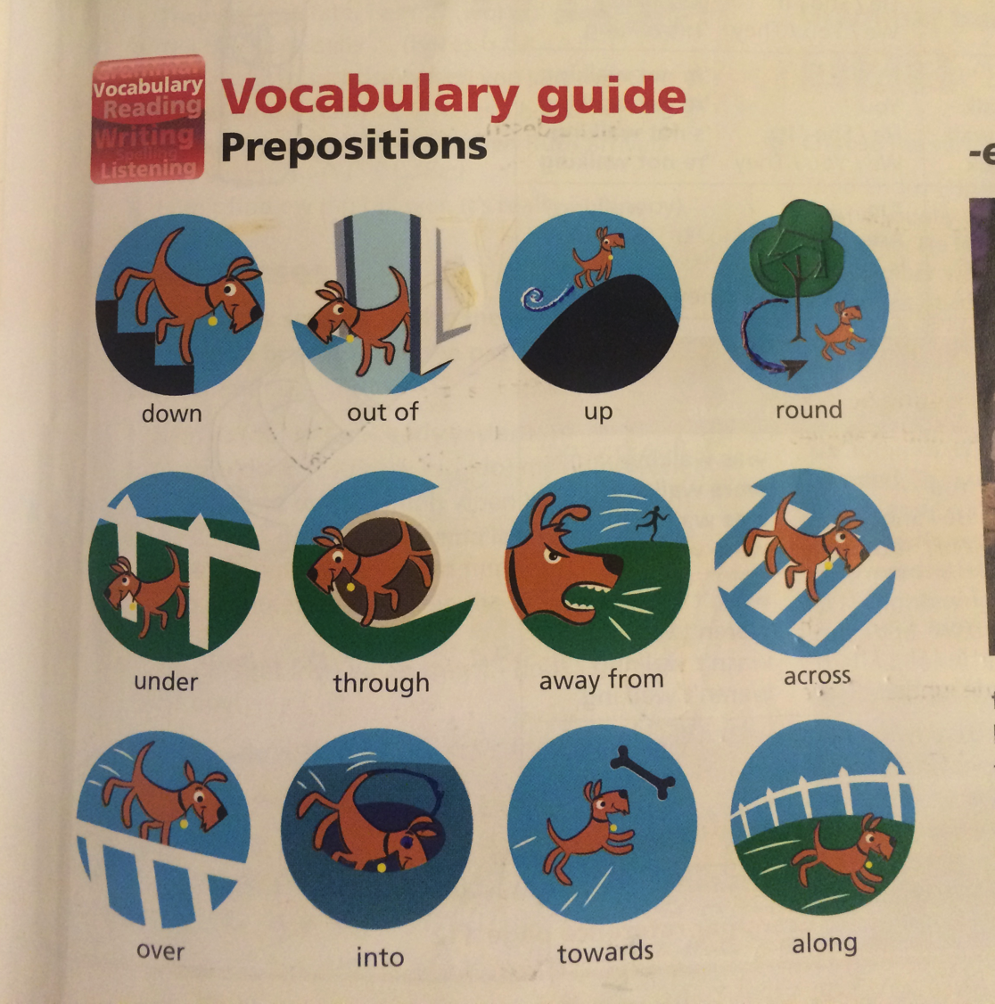

Slide 40
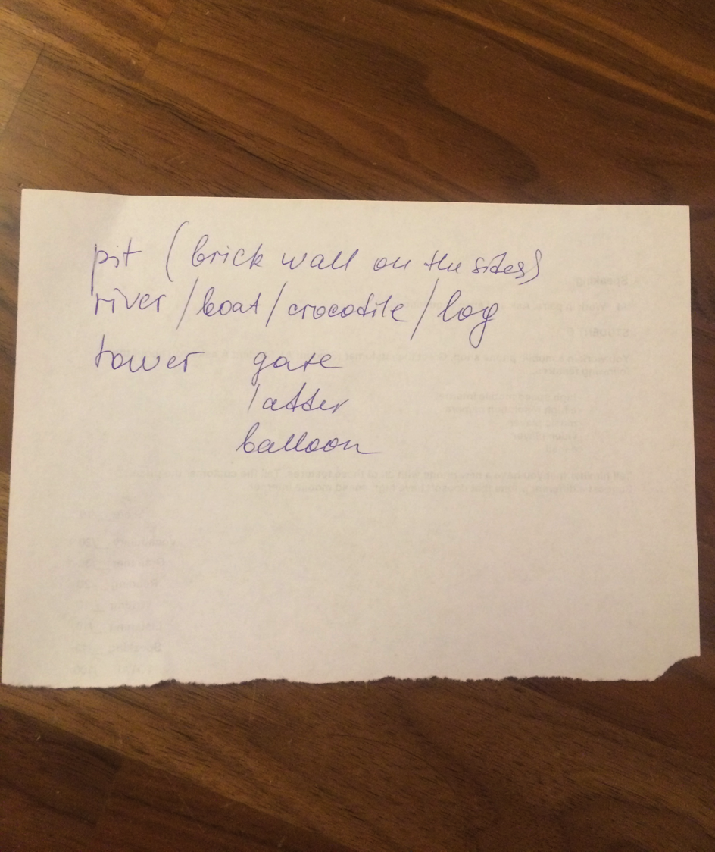

Slide 41
“Like life, it's not so much whether you win or lose, but how you play the game”
— Stephen Stratton
What Is Role-Playing

Slide 42
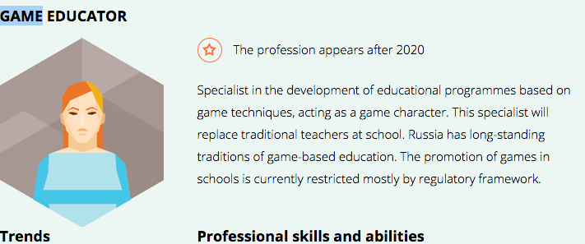
Atlas of emerging jobs

Slide 44
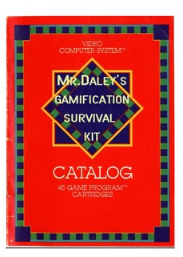
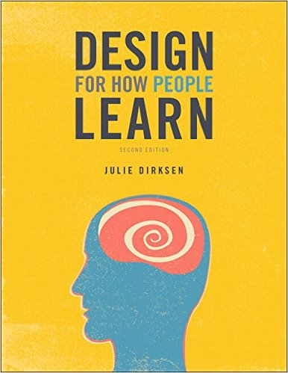
Further reading

Slide 45
To read
boardgamegeek.com
gamasutra.com
Play Understanding games
Yan Schreiber online course
Yu-kai Chou Actionable gamification
Kevin Werbach

Slide 46
studycraft.ru vk.com/study.craft facebook.com/study.craft.gamification

Slide 47
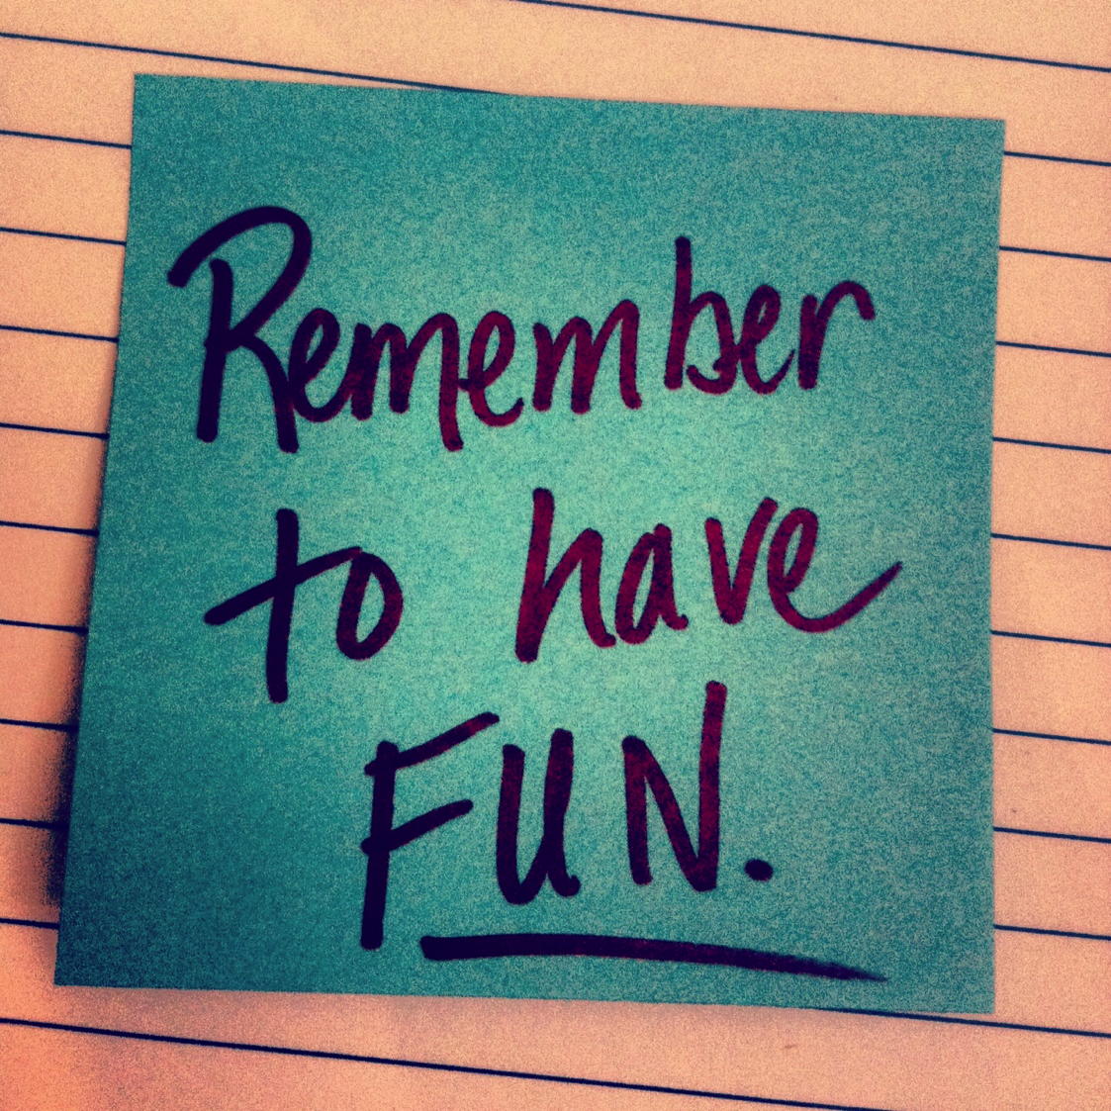
19-20, March
2-day workshop

