Slide 1


Vera Senchikova
A visit to Scotland

Slide 2



Students
always enjoy watching video
take notes with the help of Videonot.es
multiple students type and work on the same document at the same time
searches and adapts
online resources
Teacher
gets a feedback

Slide 3


From creatively announcing homework assignments to sharing classroom experiences and concepts through photographs
helps to share information
connects with students, parents and other educators

Slide 4
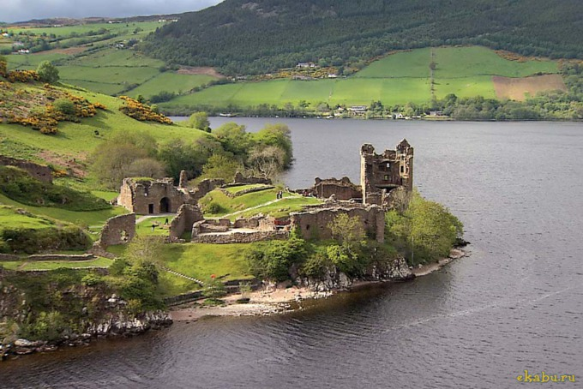

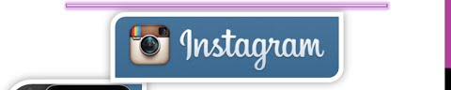
“A visit to Scotland” introduces this beautiful part of Great Britain
“My Heart’s in the Highlands” in YouTube.
https://www.youtube.com/watch?v=XrF3dPIyGeM
Famous Scottish singer Mike Olegri
Lyrics by Robert Burns, a well-known
Scottish poet
As a home task
А short video in Instagram about a big city in Scotland or a tradition or a sight.

Slide 5
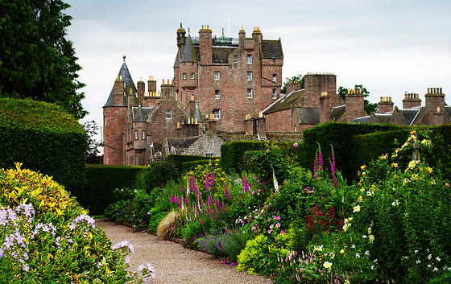

“A Visit to Scotland” the 4th lesson in section 3
“Welcome to the
United Kingdom of Great Britain”.
At the lesson students
Learn new words about Scotland
familiarize with sayings of famous poets about Scotland.
do the word Quiz to memorize the new words.
work in groups and individually.
develop communicative competence.
learn how to speak about Scotland using new lexis.

Slide 6
6th form secondary school students
Age 12
elementary level
in English
pre-intermediate level
In English
can understand many simple expressions of basic functions
can understand the gist of a commonplace conversation
can write a few simple but connected sentences on a given topic
can produce English well enough to take part if spoken to carefully.
A visit to Scotland
Step 1. Introduction the theme of the lesson, detecting the aims of the lesson.
Step 2. Familiarizing with new lexis
Step 3. Memorizing the new lexis
Step 4. Learning the lexis in the context
Step 5. Developing Listening skills
Step 6. Revising Grammar
Step 7. Speaking
a system of assignments for the development of communicative skills.

Slide 7
Step 1 The students guess the theme of the lesson by listening to a bagpipe, the National instrument of Scotland.
Step 2 The students do a vocabulary exercise. They label the pictures.
And then they check the task on the board.
Step 3 The students read the sayings of famous people and after that they watch the video on YouTube: “ My heart in the Highlands” sung by a famous Scottish singer Mike Olegri)
https://www.youtube.com/watch?v=XrF3dPIyGeM
Then they are asked to write the retelling of the song in Videonot.es.
Step 4 A dramatization with a Scottish man. Students act out a dialogue with the guest from Scotland. They sing all together his favourite song My Bonnie. It’s a karaoke. https://www.youtube.com/watch?v=dNdH44_WaqY
Step 5 and Step 6 The teacher introduces the Present Perfect Tense. The students listen to miss Present Perfect and then they do the assignments.
http://www.azargrammar.com/grammarSpeaks/fegi/fegi_chapter04/fegi_04_002.html
Step 7 The Students make a story about Scotland summarizing all the information they have got during the lesson.
Home task: the students make a short video in Instagram about a big city in Scotland or a tradition or a sight.
http://instagram.com/

Slide 8
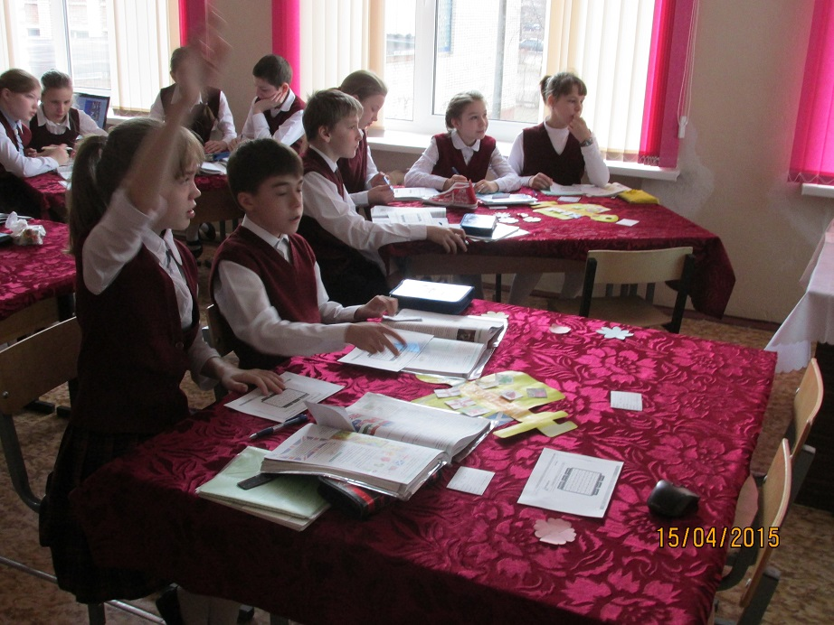
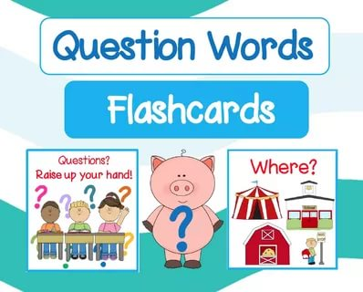
I intend both for incidental and intentional vocabulary learning. I think that the incidental and intentional vocabulary learning are important for students.
To improve incidental vocabulary learning I encourage my students to listen to English language radio programs or English pop songs or English language movies or TV shows. We also read a lot of authentic texts where they can pick up new words without meaning to keep them in the background.
All our lessons are aimed to improve the intentional vocabulary learning. Students have to learn as many new words as possible. Drilling is the best way to learn the words. Vocabulary notebooks, word cards, flashcards are of great help. There are also a lot of terrific web-based flashcard tools.

Slide 9
NO, IT DOES NOT
REASONS
1. 12 year old students are too young to have strong skills in communication.
2. they don’t have a good command in speaking and writing both in English and even in Russian.
Their task in Instagram is the first step to such type of communication which could expose them to the desired vocabulary. They can write comments for their classmates’ videos about Scotland in Instagram. But I can’t call it “community of fans”.

Slide 10
YES, IT DOES
REASONS
All the assignments of the lesson are connected with vocabulary
learning.
2. Step 2 assignment “to label the pictures with new words” helps students to learn the new words intentionally.
3. Step 3, 4 and 5 motivate the students to incidental learning.
4. Instagram assignment allows the students to improve their speaking abilities in the form of entertainment. They learn to use the new words in context.
5. Posting comments about their classmates’ videos in
Instagram helps to develop both communicative and writing skills.

