Slide 1
Past Simple.
Today is the … of …

Slide 2
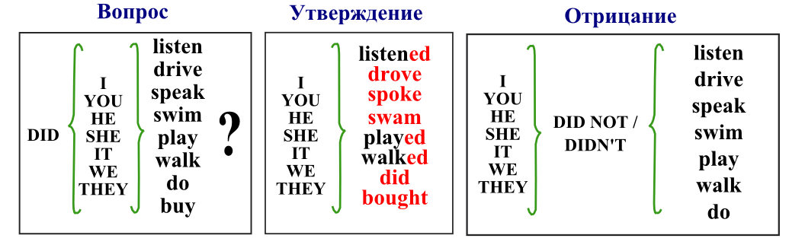

Slide 3
Irregular verbs:
Make-made- делать
Come-came-приходить
Swim-swam – плавать
Sing- sang – петь
Speak-spoke – говорить
Sit – sat - сидеть

Slide 4
Mary gets up at 7 o’clock. She washed her face and cleaned her teeth. Then she had breakfast. She takes her bag and goes to school.
Jane comes home at 2 o’clock yesterday. She had dinner. Then she cleaned her room. She does her homework. Then she played games.
3. My mother comes home from work at 6 o’clock. She cooked supper. Then she watches TV. She reads a book. She went to bed at 10 o’clock

Slide 5
Did you go abroad?
Did you play a lot in summer? Yes, I did.
Did you write a letter?
Did you read books?
Did you travel a lot?
Did you walk in the park? No, I didn’t
Did you eat ice-cream?

Slide 6


