Slide 1
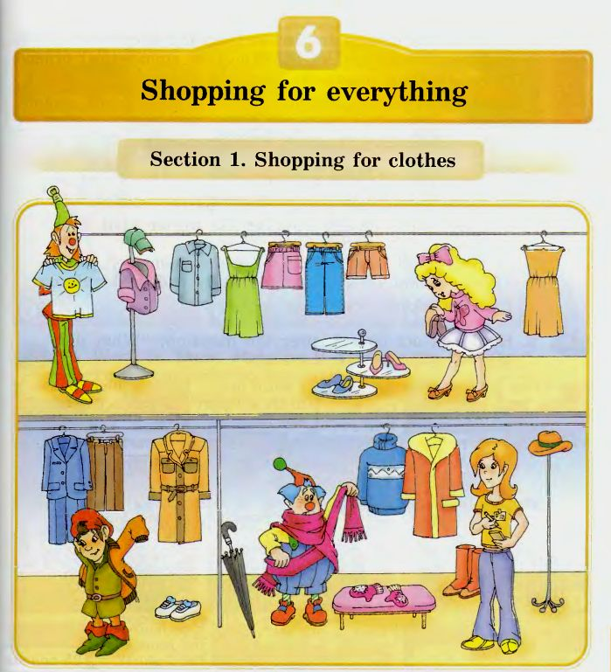

Slide 2
Listen to the shop assistant.
Name the clothes she has got in the shop
We’ve got… nice dresses, shoes, shorts, a blue shirt, a green cap and blue jeans for summer.
You can buy… an orange raincoat, a blue suit, brown trousers, white trainers and an umbrella for rainy autumn.
There is… a warm coat, a long scarf, a blue sweater, nice mittens, a hat and red boots for cold winter.

Slide 3
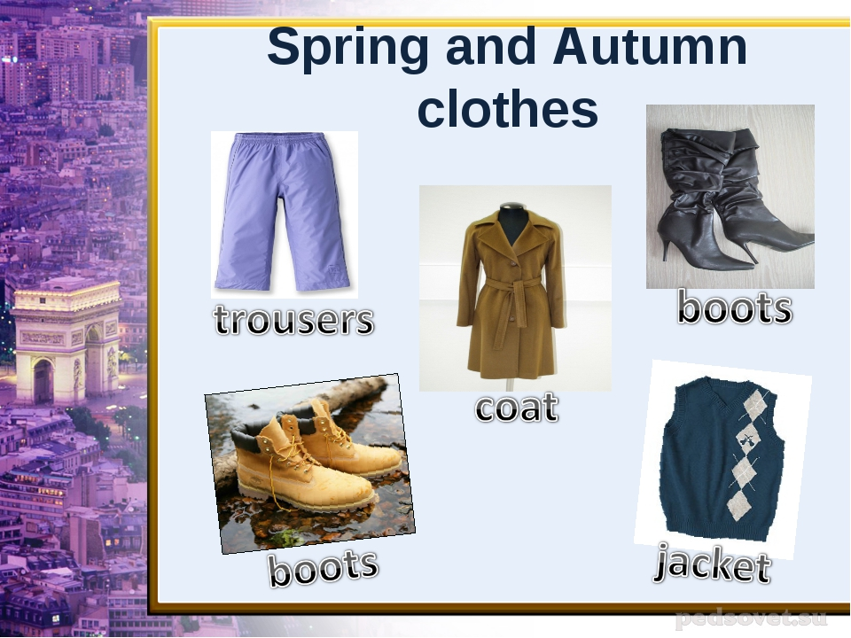
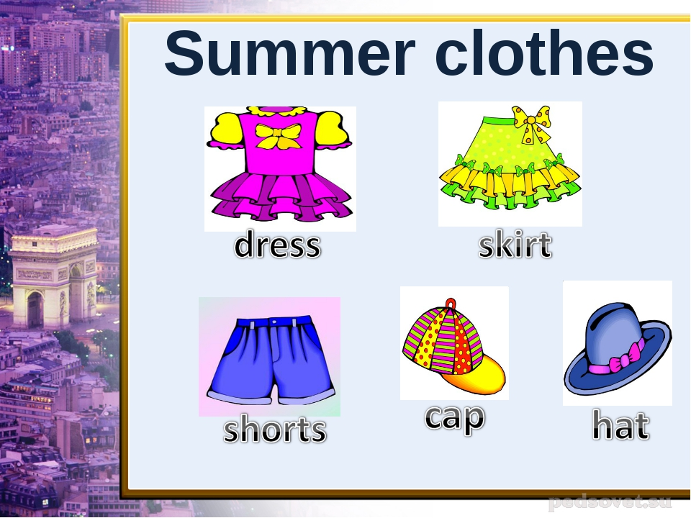

Slide 4
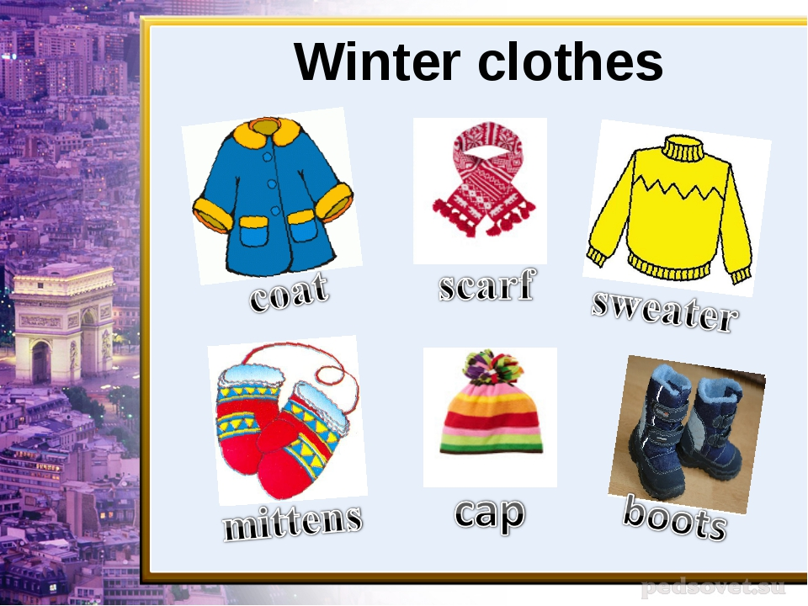

Slide 5
[∂u] | [ei] | [∫] | [e] | [u:]
hope | away | shirt | red | room
clothes | play | T-shirt | help | blue
show | raincoat | shoes | dress | boots
coat | trainers | shorts | sweater | shoes

Slide 6
Help the shop assistant to make a list of things in alphabetical order
A…
B…. blouse, boots
C… coat, cap
D… dress
J… jacket, jeans
M… mittens
R… raincoat
S… scarf, shoes, suit, sweater
T… trainers, trousers, T-shirt
U…umbrella

Slide 7
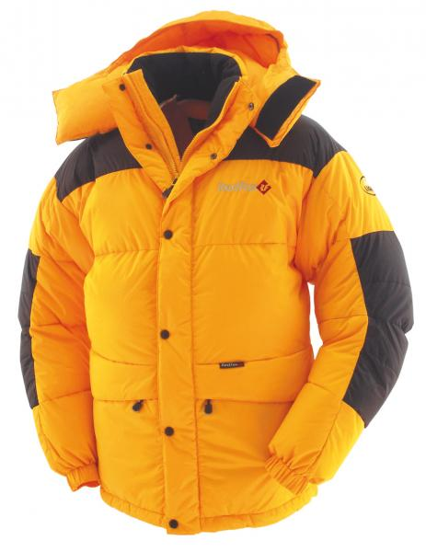
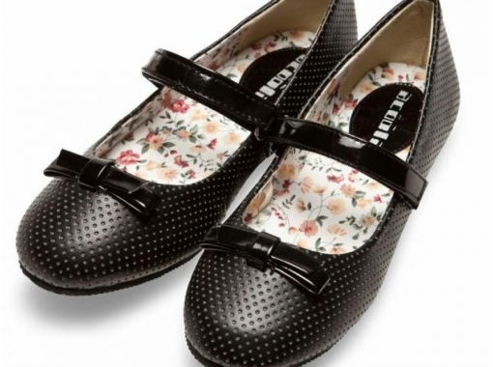
What Alice,Tiny would like to buy in the shop?
Alice would like to buy…..for a party.
Tiny would like to buy….. for his winter visit to Russia.

Slide 8
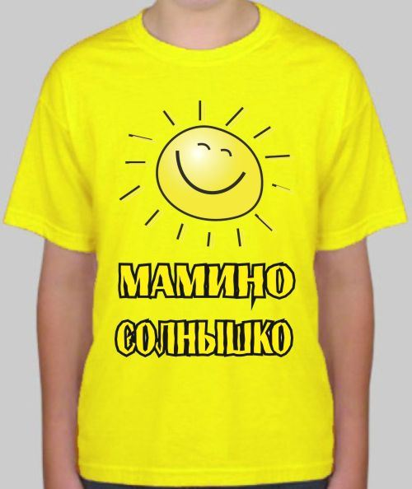
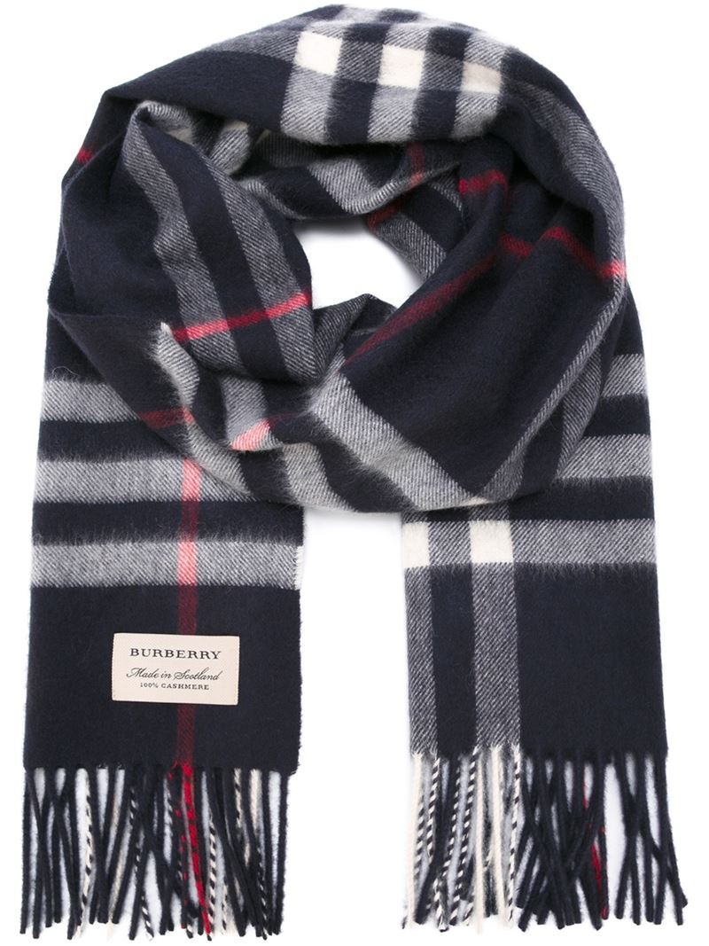
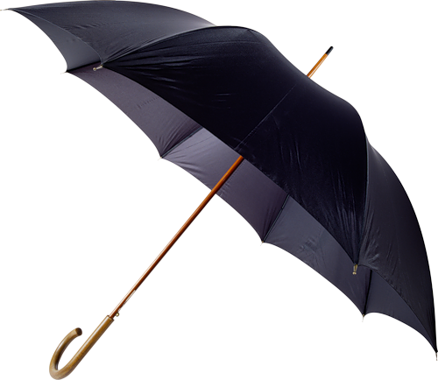
What Tim and Tom would like to buy…?
Tim would like to buy….. for sunny summer.
Tom would like to buy…..for a rainy weather.

Slide 9
Tiny would like to buy clothes for his birthday party and for a picnic. Work in pairs. Make up a dialogue «In the shop»
- Hello!
- Hello! Can I help you?
- I would like to buy…for my birthday party ( for a picnic).
- What colour?.....
- Does it suit me?.....
- How much (is) are…?..... (pounds)
- Here it is.
- Thank you…..
- Goodbye!

Slide 10
Make up word combinations or sentences with these words
big
short
small
long
nice
new
dirty
clean
brown,red,black, green,yellow,orange
Blouse, T-shirt
boots, trainers
cap, shoes
coat, trousers
dress, raincoat
jacket, clothes
jeans
mittens
sweater

