Slide 1
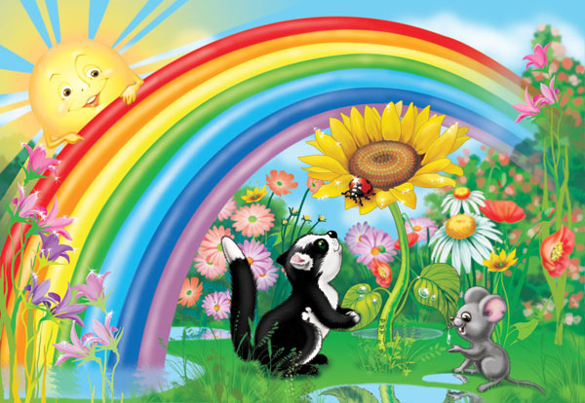
Colours
What colour is this object?

Slide 2
Repeat words and phrases
Light-bright
Fat-thick-thin
Rainbow-window
Sparrow-narrow
Low-slow
New-old-young
Weak-strong
Can-can’t
What colour is…? What colours are…?

Slide 3
Listen to the speaker and say, which phrase will you hear
1) a) Mary and Sue can play very well together.
b) Mary and Sue can’t play very well together.
2) a) We can swim in the lake in the morning.
b) We can’t swim in the lake in the morning.
3) a) The little dog can eat big bones.
b) The little dog can’t eat big bones.
4) a) You can see the bright blue sky now.
b) You can’t see the bright blue sky now.
5) a) Birds can be very big and strong.
b) Birds can’t be very big and strong.
6) a) Peter can read thick English books.
b) Peter can’t read thick English books.
7) a) James Cook can teach Russian.
b) James Cook can’t teach Russian.

Slide 4
Read these words and deсide which word in not suitable
pink, purple, white, low, grey
thin, thick, narrow, flat, window
sparrow, kangaroo, flag, mouse, fish
house, ship, car, plane, lorry
parent, school, girl, grandfather, pupil

Slide 5
Read the text about Robin Scott and answer the questions
Is Robin a student or a pupil?
Where is he from?
Are his parents in London?
Are they old? Are they weak?
Is his father a pilot?
Is his car bright blue or bright green?
Where are his grandparents?

Slide 6
What can you do well?
What can you do but not very well?
What can’t you do?
I can ….. well.
I can ….. but not very well.
I cannot (can’t) ……

Slide 7
Name animals or thing who can be …?
noun
adjective
1) A mouse
2) ……….
3) ……….
4) ……….
5) ……….
6) ……….
7) ……….
8) ……….
9) ……….
can be white.
can be strong.
can be bright yellow.
can be new.
can be young.
can be slow.
can be narrow.
can be grey.
can be dark.

Slide 8
What the english say when they want to know
1)Откуда ты родом?
2) Как у тебя дела?
3) Как тебя зовут?
4) Сколько тебе лет?
5) Какого цвета твоя машина?
6) Который час?
7) Где ты находишься?
8) Ты ученик?
9) Ты счастлив?
Where are you from?
How are you?
What’s your name?
How old are you?
What colour is your car?
What’s the time?
Where are you?
Are you a pupil?
Are you happy?

Slide 9
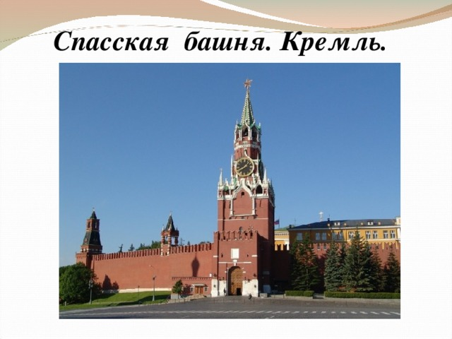
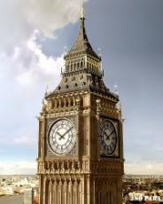
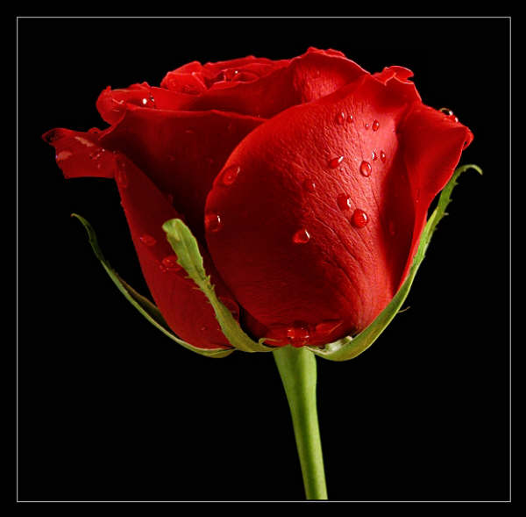
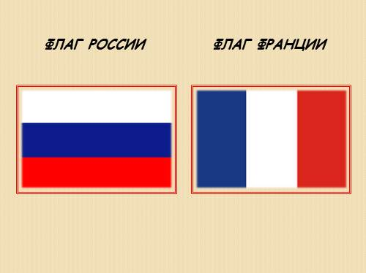
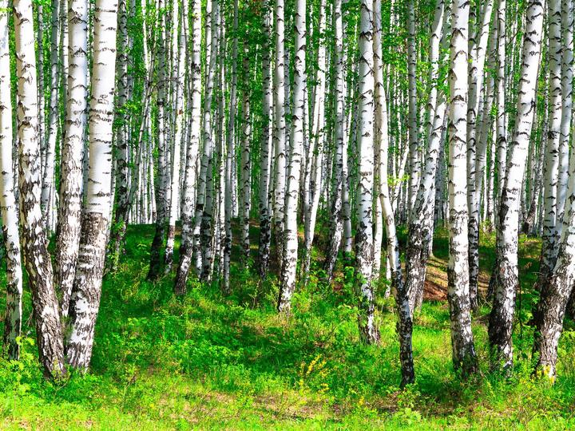
Which of these pictures are symbols of russia, england and france?

Slide 10
Which of these pictures are symbols of russia, england and france?
Russia | England | France
1) The Spasskaya Tower | 2) Big Ben | 4) The blue, white and red flag
3) The white, blue and red flag | 6) The red rose
5) The birch

Slide 11
Connect the words in these columns to make the phrases
A bright blue
A young
A little grey
A slow
A strong
A thick
A yellow
A little grey and brown
A green narrow
sky
horse
banana
book
girl
street
mouse
turtle
sparrow

Slide 12
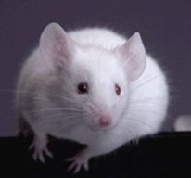
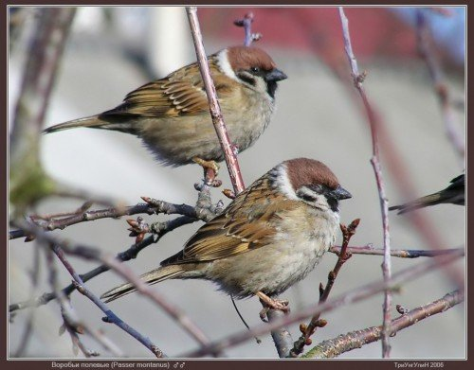
What colour is the mouse?
It is …..
What colours are the sparrows?
They are …..

Slide 13

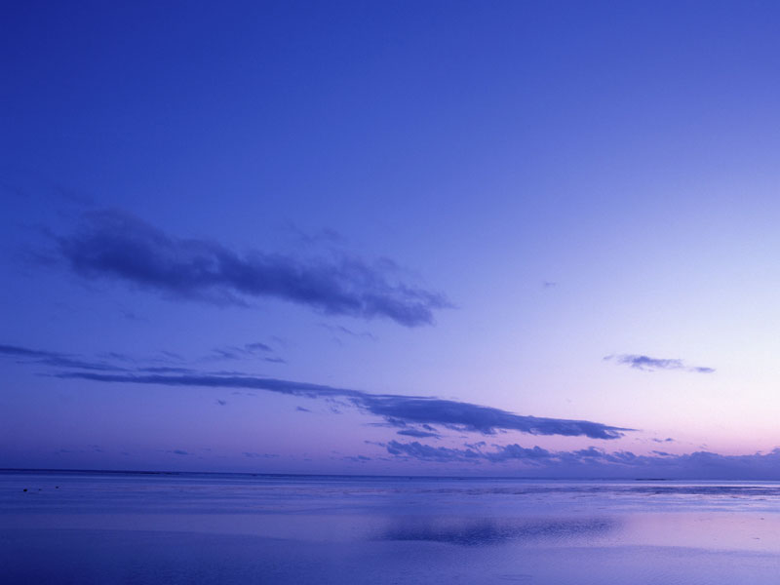
What colour is the sun? It is …..
What colour is the sky? It is …..

Slide 14
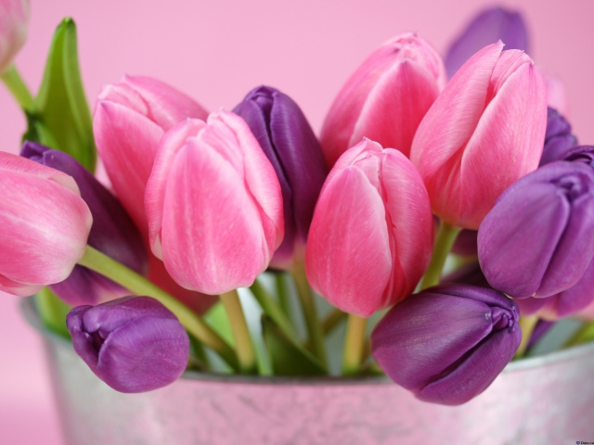
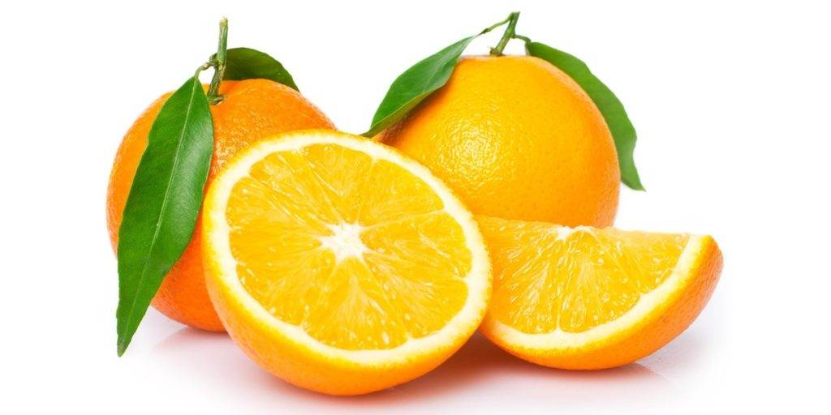
What colours are the tulips?
They are …..
What colours are the oranges?
They are …..

Slide 15

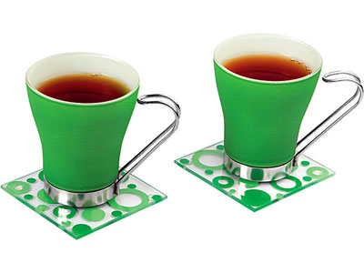
What colour is the book? It is …..
What colours are the cups?
They are …..

Slide 16
What can (can’t) we do on the street in winter?
We can …
We can speak Russian in the street.
- sleep,
- sing songs,
- play computer games.
We can’t …
We can’t cook in the street.
- ride the bike,
- see flowers,
- swim in the lake,
- read books.

Slide 17

Seven colours of the rainbow

