Slide 1
Создай свой банк вопросов: простые приёмы и бесплатные ресурсы для организации классных дискуссий
Международная научно-практическая онлайн-конференция «Современные технологии в обучении английскому языку»

Slide 2
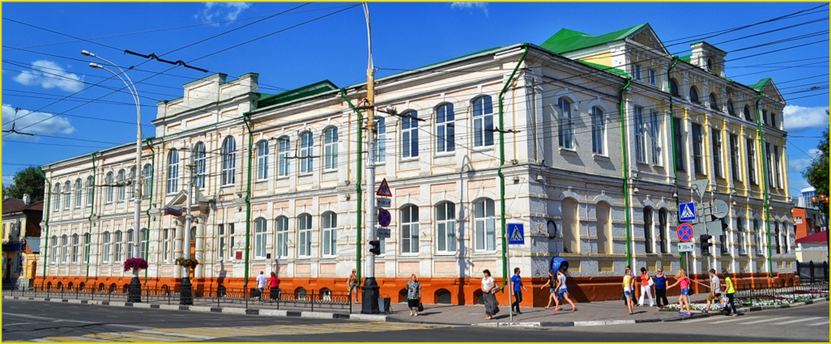
Старовойтова Ирина Юрьевна
Учитель английского языка высшей категории,
МАОУ «Лицей №6», г. Тамбов

Slide 3
Доступные бесплатные ресурсы
Любая тема.
Любой класс.
Бонус: обсуждая проблемы, готовимся к написанию эссе.

Slide 4
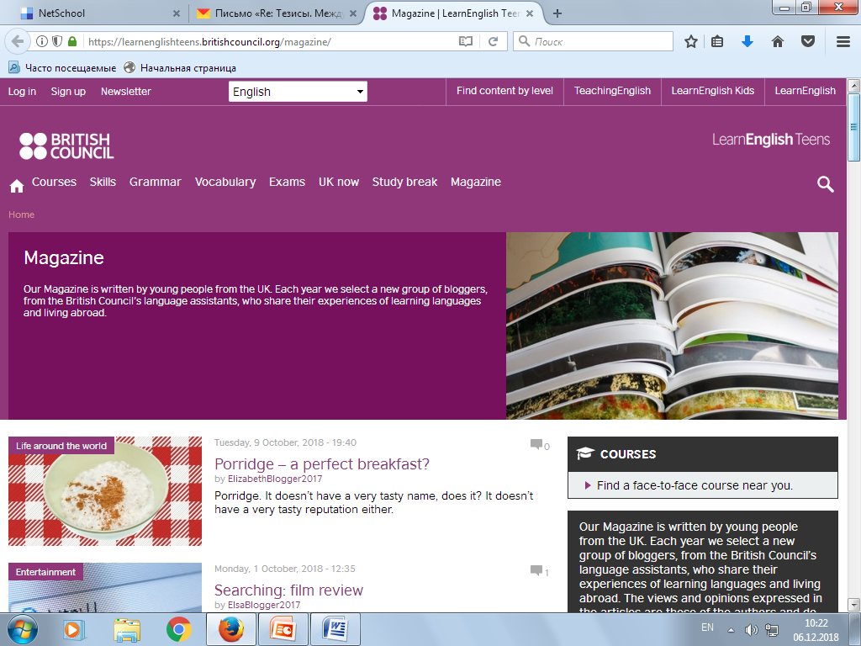
Журнальные статьи по самым разным темам
https://learnenglishteens.britishcouncil.org/magazine/

Slide 5
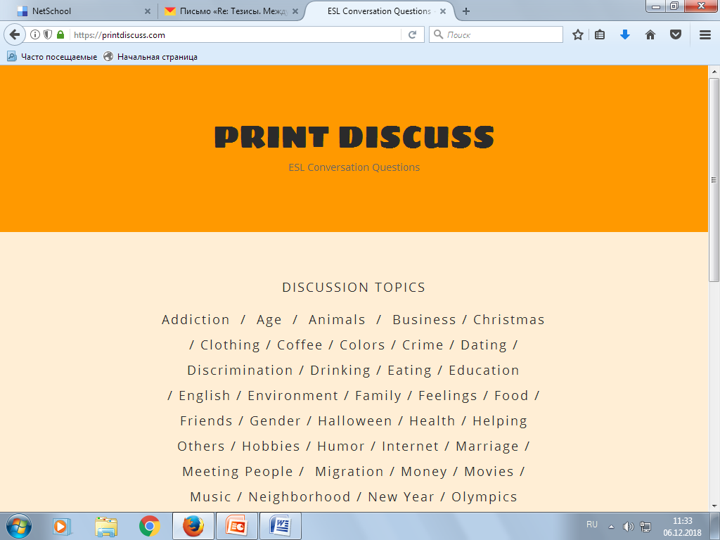
Готовый банк вопросов ESL
https://printdiscuss.com/

Slide 6
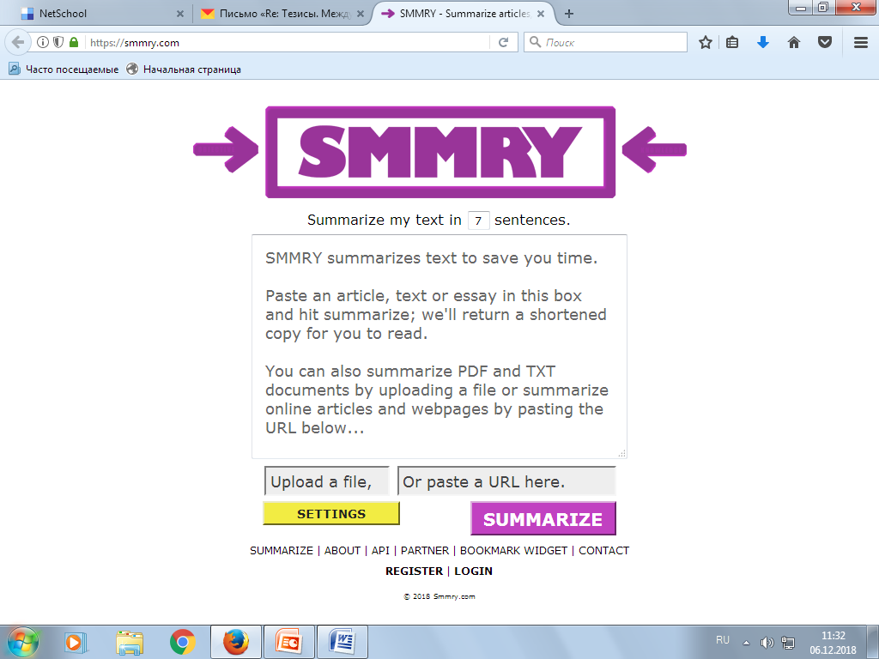
Простой инструмент сокращения текстов
https://smmry.com/

Slide 7
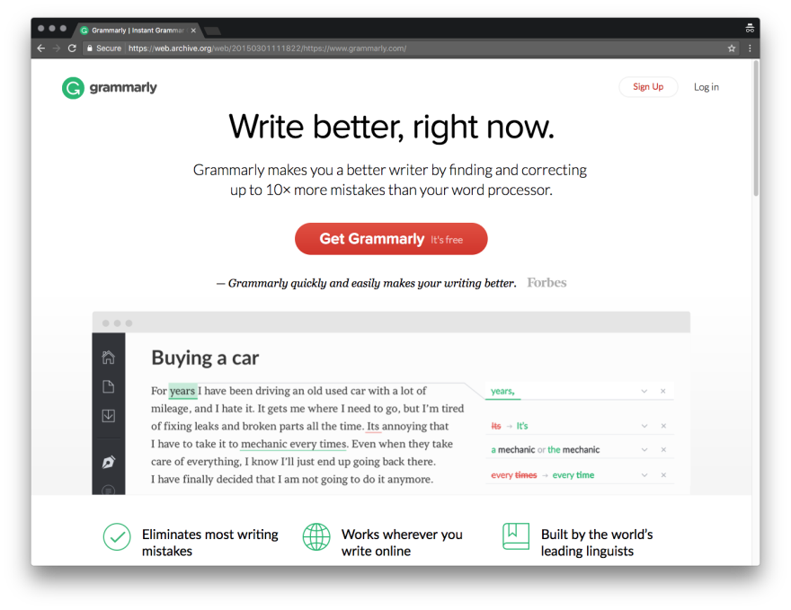

Удобный инструмент проверки текстов
https://www.grammarly.com/

Slide 8
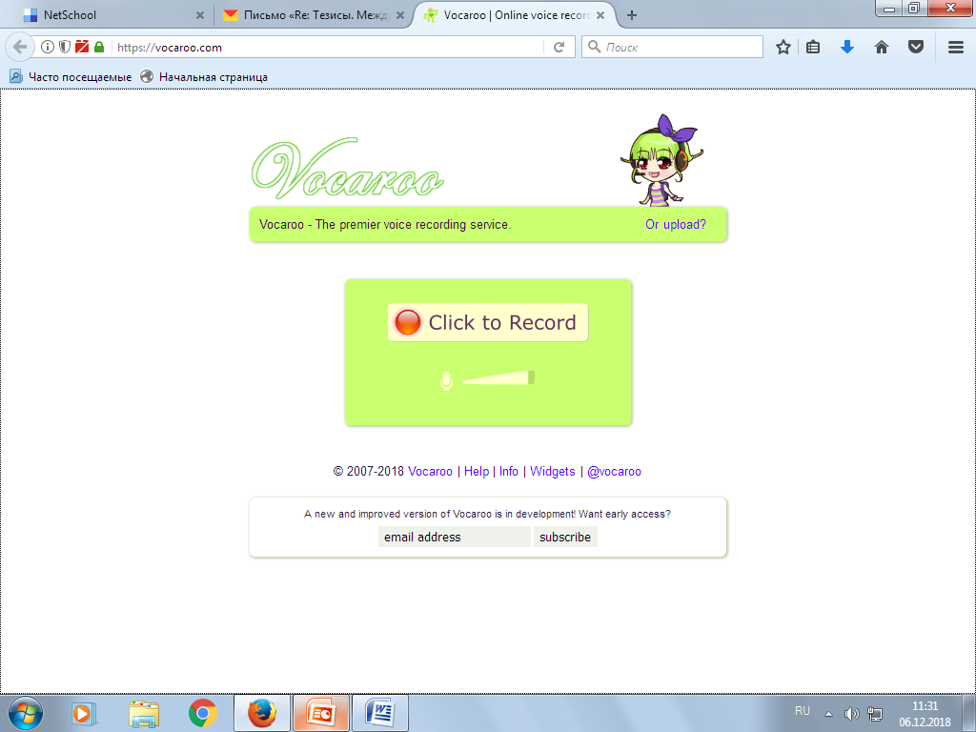
Запись, сохранение и обмен аудио
https://vocaroo.com/

Slide 9
Использование ресурсов при подготовке и проведении урока
План урока с использованием рассмотренных ресурсов по теме «Космос и космонавтика»

Slide 10
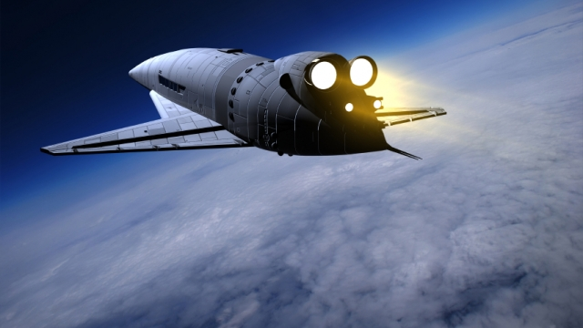
Space tourism
Space discussion
https://learnenglishteens.britishcouncil.org/magazine/science-and-technology/what-space-tourism
Описание картинки; прогнозирование содержания текста
Заголовок: Space tourism
What is space tourism?

Slide 11
Чтение с извлечением информации:
Space tourism is the term used to describe space travel for recreational or leisure purposes. What was once only a dream – described in books such as Arthur C. Clarke's 2001: A Space Odyssey – is now becoming a reality.
Futurologists are scientists who attempt to develop predictions of what life will be like in the future. After the first man landed on the moon in 1969, they thought that hotels would be built on the moon by the year 2000. Futurologists also considered the possibility that, in the 21st century, families might go for a holiday on the moon. Neither of these predictions have come true yet – but the rapid development of technology may mean these predictions are a possibility in the years to come.
Space Adventures is currently the only company to have succeeded in sending paying passengers into space. Space Adventures worked with the Federal Space Agency of the Russian Federation and Rocket and Space Corporation Energia to facilitate flights for the world's first private space explorers. Each person paid over $20 million for their 10-day trip to the International Space Station.
Following several successful explorations into space, several companies are now considering the possibility of enabling tourists to visit space. In order to make it more affordable, suborbital space travel is being considered by many companies, including Virgin Galactic. Passengers would be transported to a height of between 100 and 160km above earth, experience 3–6 minutes of weightlessness and a view of the stars before being taken back down to earth. This is expected to cost around $200,000 per person.
Whilst it could be an enriching experience, there are some disadvantages to space tourism. Many critics have commented that a huge growth in the spaceflight industry could drastically speed up the process of global warming. The ozone layer would be damaged further and the polar regions would suffer. In addition, space travel is only really a possibility for the super-rich. Although Virgin Galactic claims to be 'opening space to the rest of us', there are still millions of people worldwide who wouldn't be able to afford it.

Slide 12
Нахождение ключевых слов: (SEO)
Key words: Space tourism, space travel, Futurologists, private space explorers, International Space Station, spaceflight industry

Slide 13
Краткое изложение прочитанного: Summary
Space tourism is the term used to describe space travel for recreational or leisure purposes.
Space Adventures is currently the only company to have succeeded in sending paying passengers into space.
Space Adventures worked with the Federal Space Agency of the Russian Federation and Rocket and Space Corporation Energia to facilitate flights for the world's first private space explorers.
Each person paid over $20 million for their 10-day trip to the International Space Station.
Following several successful explorations into space, several companies are now considering the possibility of enabling tourists to visit space.
In order to make it more affordable, suborbital space travel is being considered by many companies, including Virgin Galactic.
Space travel is only really a possibility for the super-rich.

Slide 14
Обсуждение в парах:
Would you like to travel into space? Why or why not?
What do you think about space tourism?
How important is learning about space?
Will humans ever travel to different solar systems?
What is the most interesting thing you know about space?
What is your favorite space movie or TV show? How realistic is it?
Would you agree to help colonize a planet if you knew you couldn’t come back to earth?
What is the most interesting planet (besides Earth) in our solar system?
What is the most important thing for astronomers to research?
What characteristics make a good astronaut?
What do you think of your country’s involvement in space?

Slide 15
Написание эссе по теме на выбор:
Would you like to travel into space? Why or why not?
Would you agree to help colonize a planet if you knew you couldn’t come back to earth?
What do you think about space tourism?

Slide 16
Индивидуальная образовательная траектория
Домашнее задание разного уровня сложности на выбор учащихся

Slide 17
Домашнее задание по выбору
(выполнить задания ДО и ПОСЛЕ выбранного видеофильма):
Как вымыть голову в космосе? https://learnenglishteens.britishcouncil.org/study-break/video-zone/how-wash-your-hair-space
Что будет, если отжать мокрую одежду в космосе? https://learnenglishteens.britishcouncil.org/study-break/video-zone/science-experiment-space
Арахисовое масло и желе в космосе https://learnenglishteens.britishcouncil.org/study-break/video-zone/peanut-butter-jelly-space
Прыжок из стратосферы https://learnenglishteens.britishcouncil.org/study-break/video-zone/record-breaking-skydive
Полет в невесомости https://learnenglishteens.britishcouncil.org/study-break/video-zone/zero-g-flight
Черные дыры https://learnenglishteens.britishcouncil.org/study-break/video-zone/black-holes

Slide 18
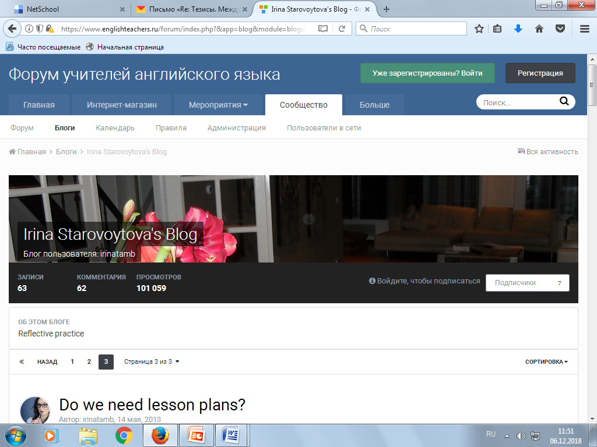
Больше материалов в блоге

