Slide 1

Sport

Slide 2




Match
A
play volleyball
play football
play ball games
play basketball
B
C
D

Slide 3
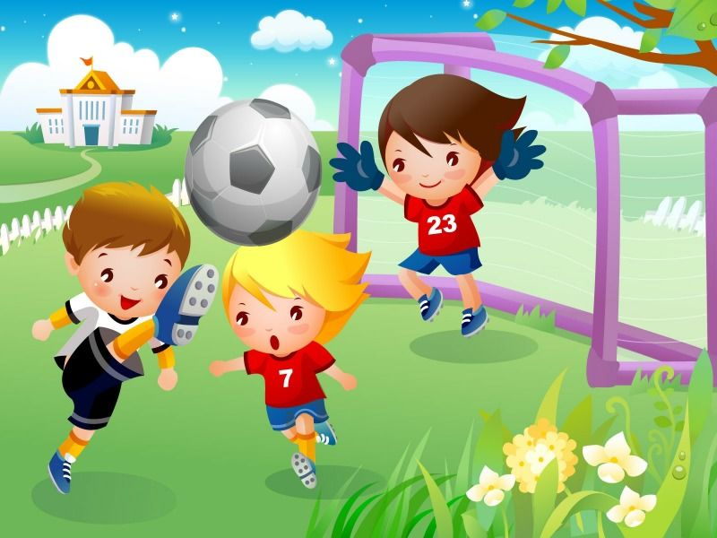
play football [plei ‘fʋtbɔ:l]

Slide 4
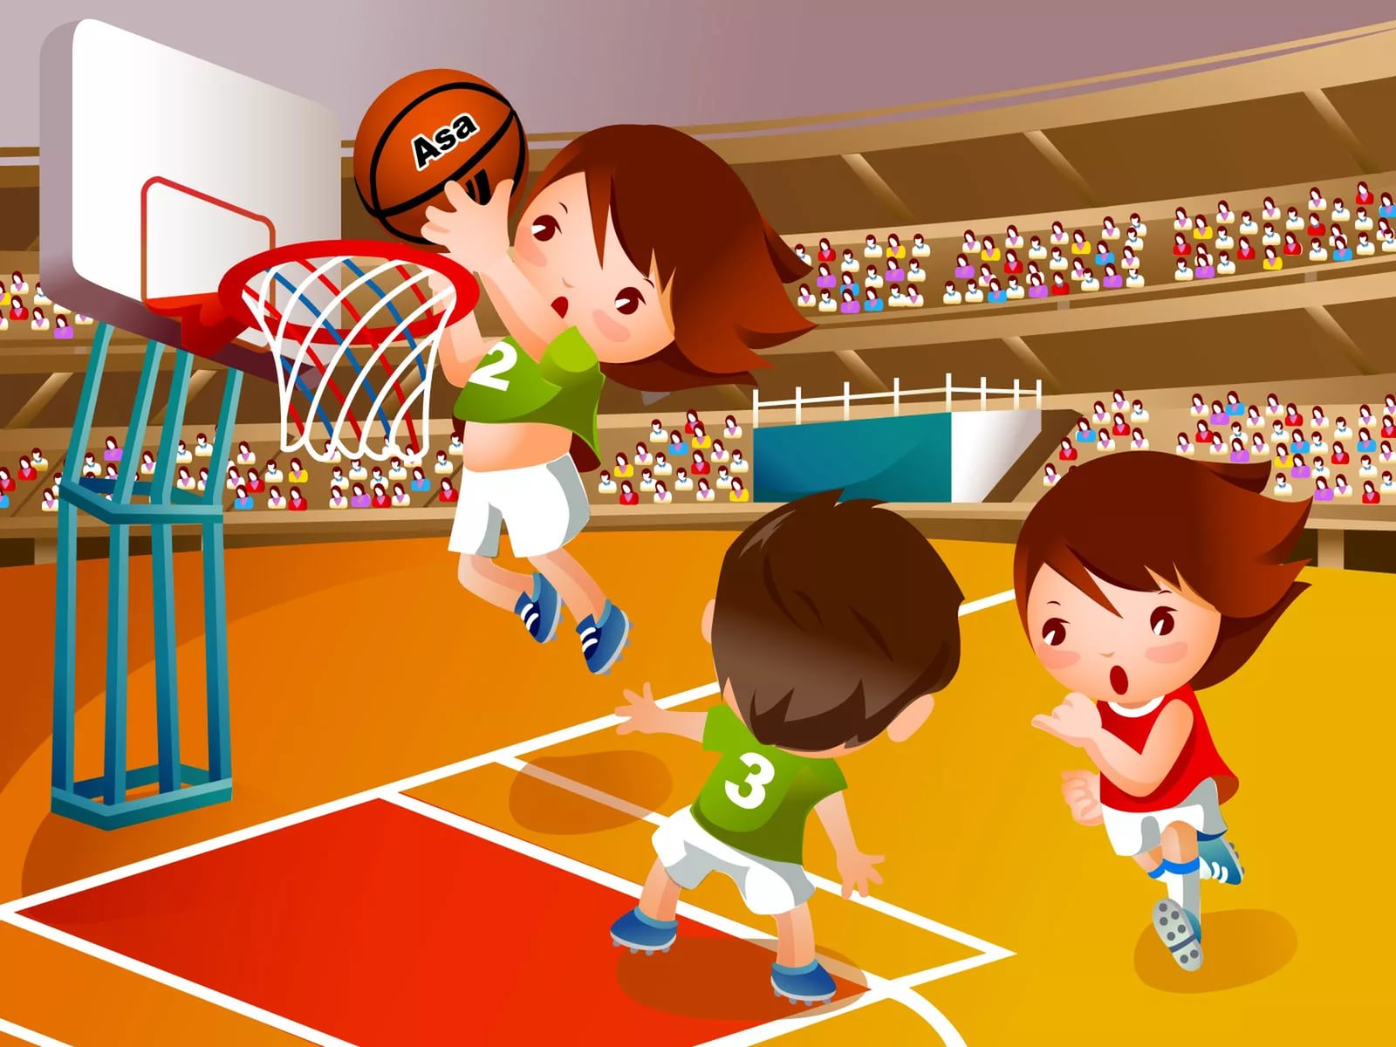
play basketball [‘ba:skitbɔ:l]

Slide 5
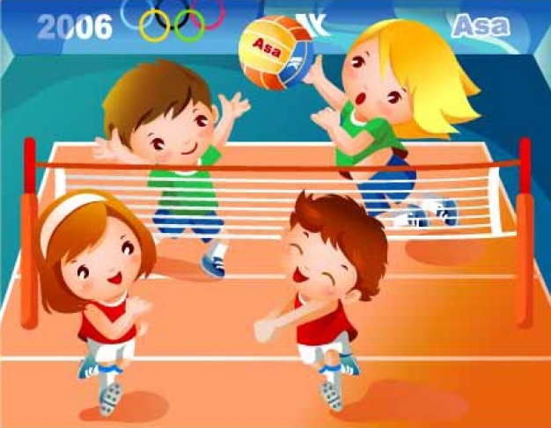
play volleyball [‘vɒlibɔ:l]

Slide 6
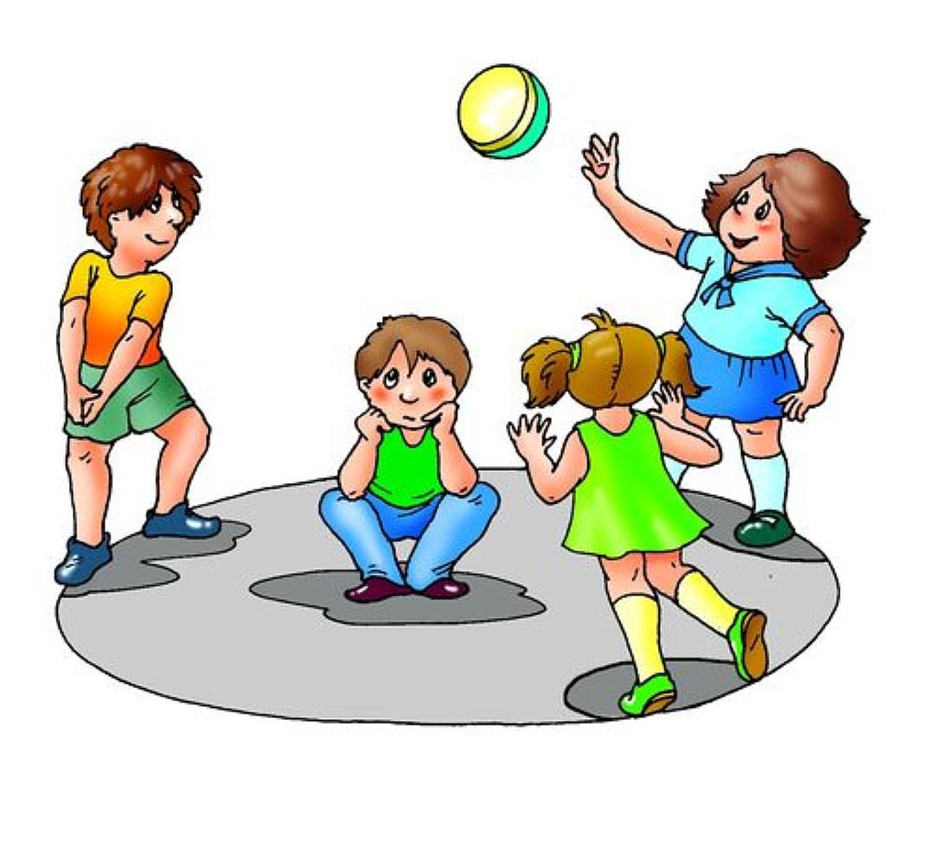
play ball games

Slide 7
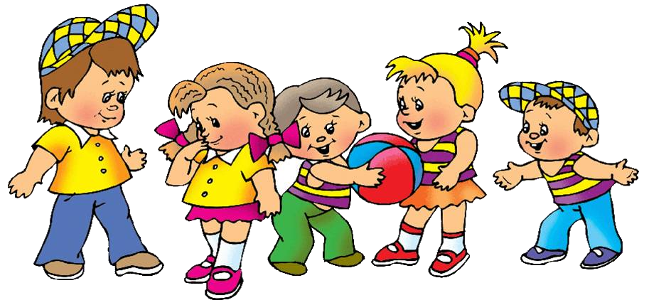
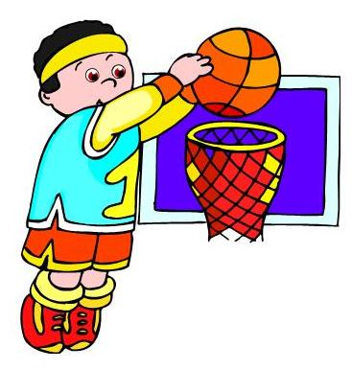

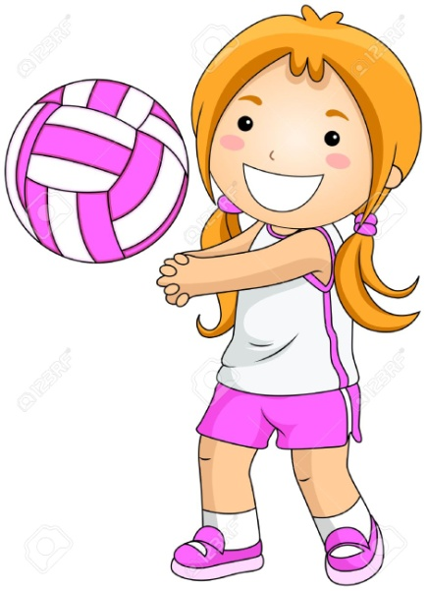
Can you play….?

Slide 8
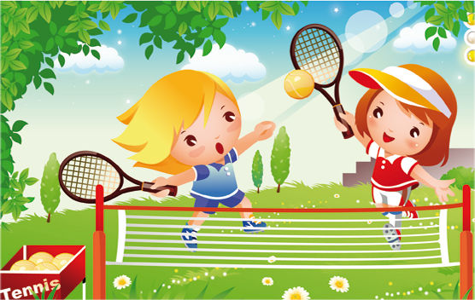
play tennis [‘tenis]

Slide 9
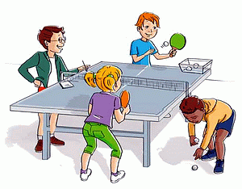
play table tennis

Slide 10
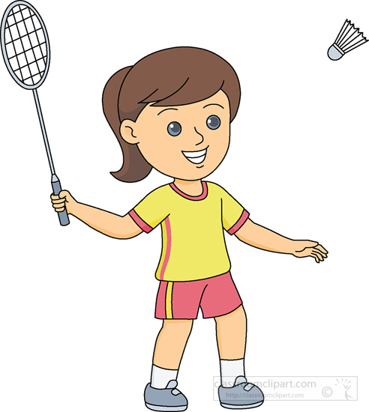
play badminton [‘bædmintən]

Slide 11
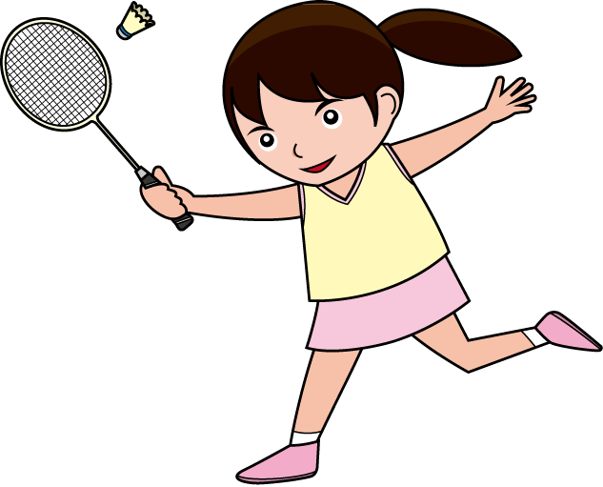
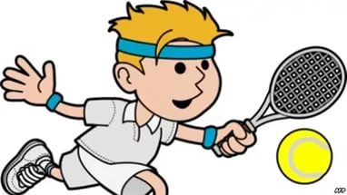
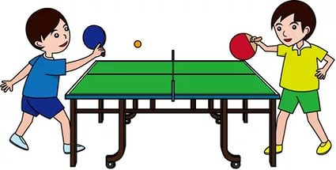
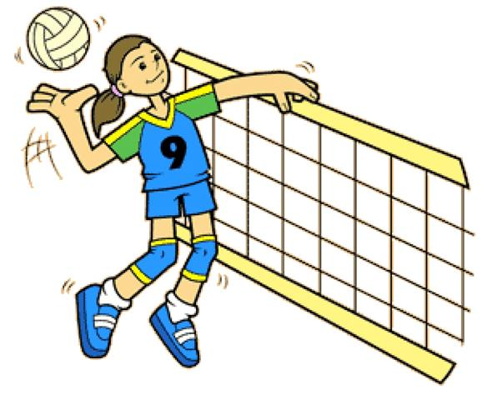
I like to play…
I want [wɒnt] to play…

Slide 12
Составь предложения
play I tennis table to want
I want to play table tennis.
2) play volleyball I can
I can play volleyball.
3) play we games like ball to
We like to play ball games.
4) play like to I basketball
I like to play basketball

Slide 13
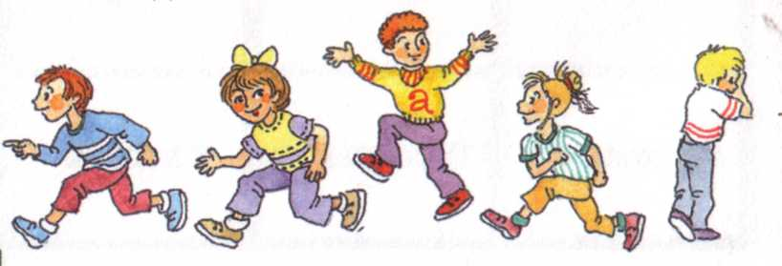
play hide-and-seek [haidn’si:k]

Slide 14
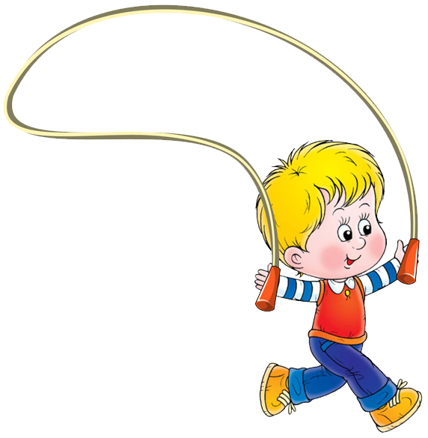
skip [skɪp]

Slide 15
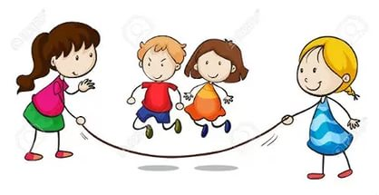
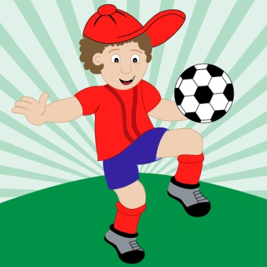
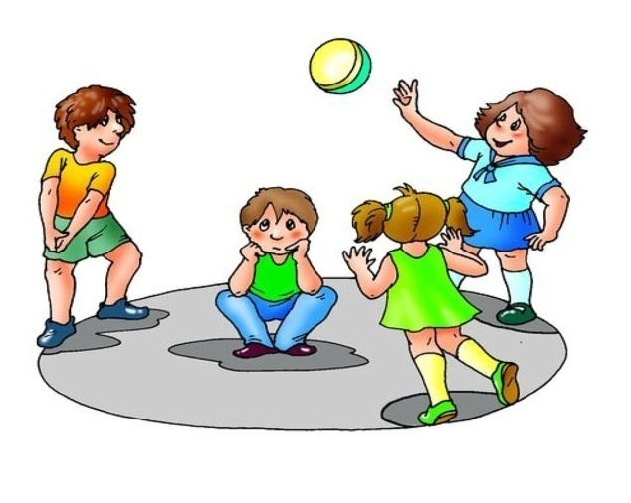
Do you like to….?
Yes, I do No, I don’t

Slide 16
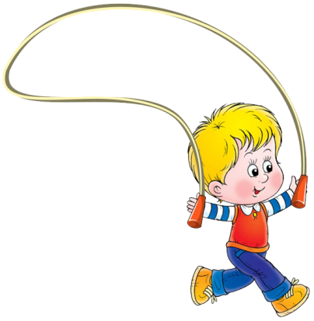
Do you want to…?
Yes, I do No, I don’t

Slide 17
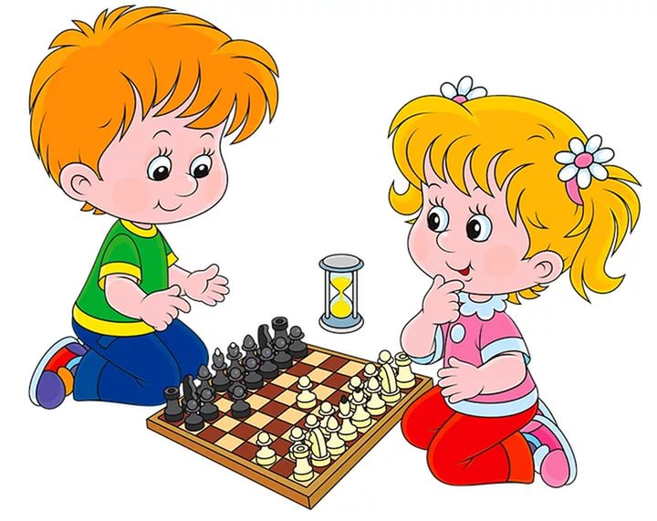
play chess [tʃes]

Slide 18
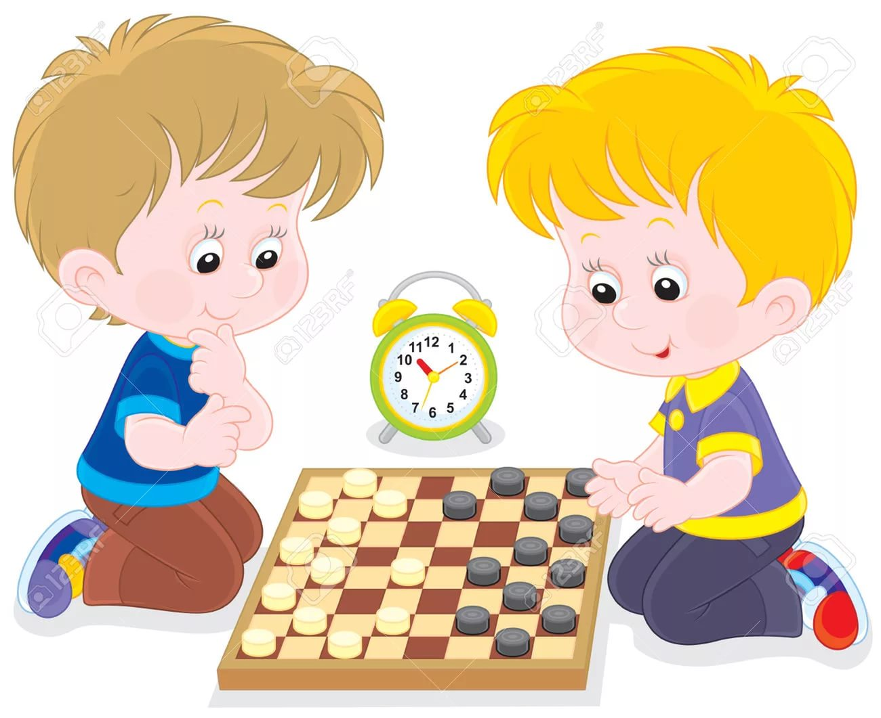
play checkers [‘tʃekəz]

Slide 19
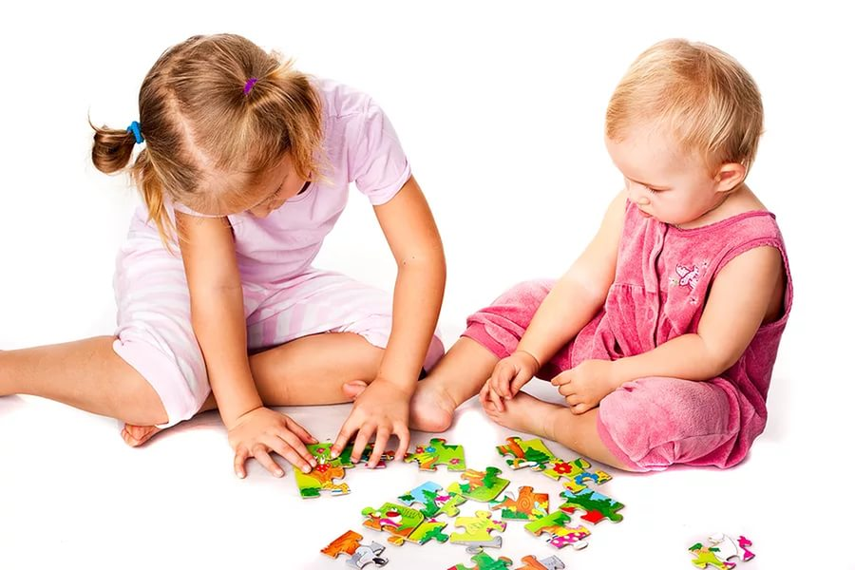
do puzzles [‘pʌzls]

Slide 20
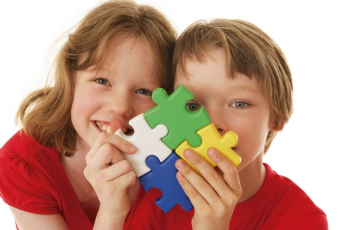
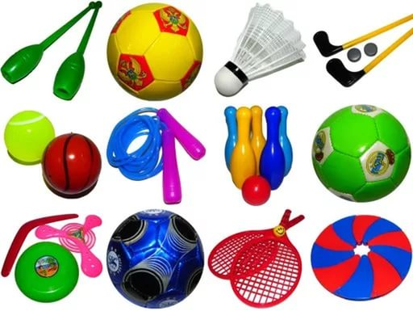
What games do you want to play?
play chess
play checkers
do puzzles
play hide-and-seek
play football
play volleyball
play badminton
play table tennis

Slide 21
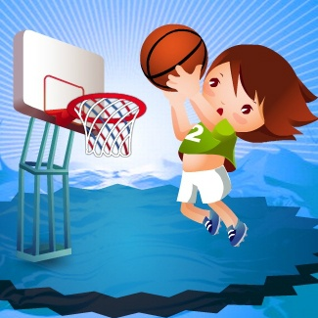
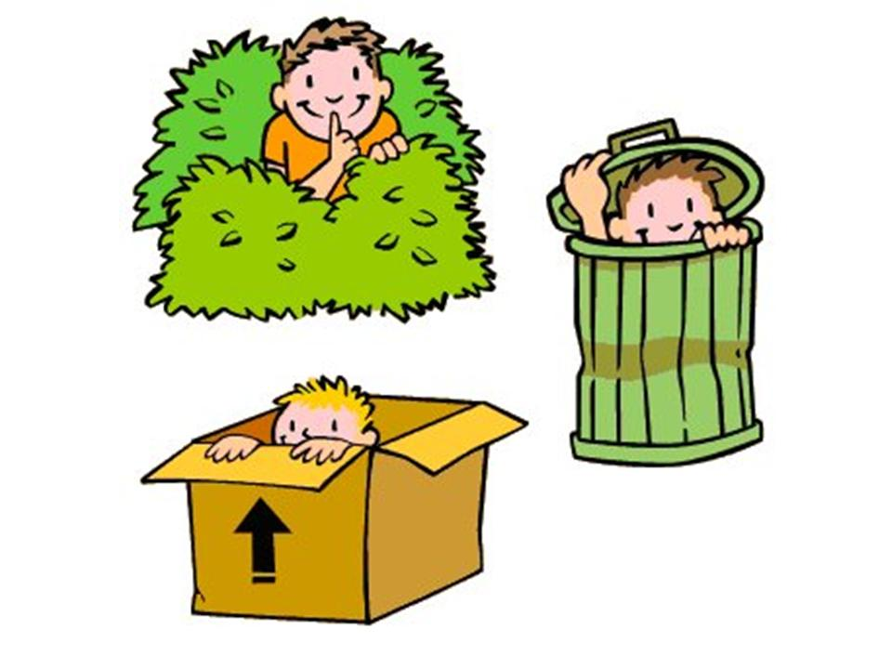
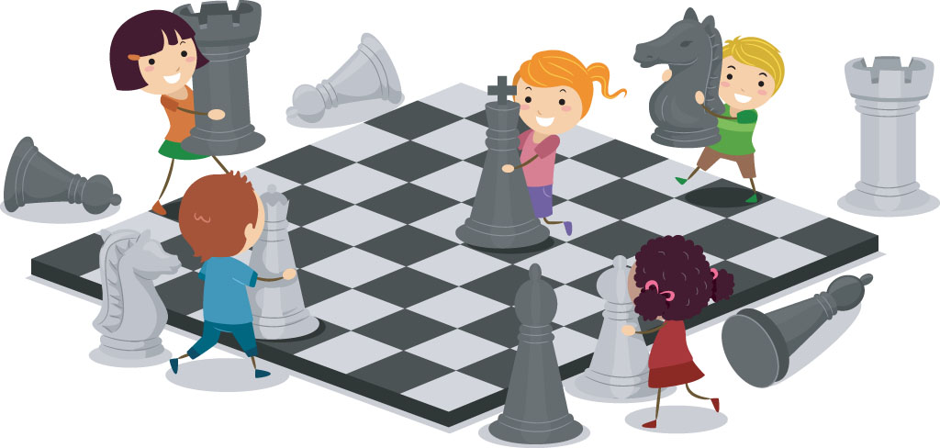
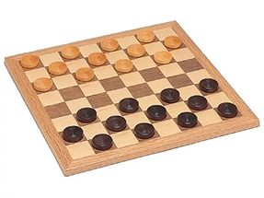
Do you like to play …..?
Yes, I do No, I don’t

Slide 22
Что пропущено?
What games do you like to play?
We like to play ball games.
What games do you like to play?
The girls like to play chess.
What about table games?
We like to do puzzles .

