Slide 1
PRESENT PERFECT
(настоящее завершенное время)

Slide 2
I | have | protected
You | have | cooked
We | have | helped
They | have | cleaned
He | has | decorated
She | has | listened
It | has | visited

Slide 3
Have / has +V ed

Slide 4
We (just / visit) ________________ the zoo.
I (already / clean) _____________________ my room.
She (just / cook) __________________ the dinner.
My sister (watch) _______________ TV.
They (play) ___________________ chess.
Tom (already / help) _________________ people.
My friend (enjoy) _____________ the show.
have just visited
have already cleaned
has just cooked
has watched
have played
has already helped
has enjoyed

Slide 5
I (decorate) ________________ the room.
They (watch) _________________ the film.
She (visit) __________________ her friend.
My brother (jump) _______________ .
We (ask) ___________________ our friends.
Bella (try) _________________ a new dress on.
My friends (dance) _____________ .
have decorated
have watched
has visited
has jumped
have asked
has tried
has danced

Slide 6
have / has + just+ Ved
have / has + already+ Ved

Slide 7
He (already play) ___________________ computer games.
We ( just open) ___________________________ the book.
They (already decorate) _______________________ the Christmas tree.
I (just travel) __________________ to America.
She ( already collect) _____________________ a lot of posters.
My son (just switch on) _____________________ a computer.
has already played
have just opened
have already decorated
have just travelled
has already collected
has just switched on

Slide 8
I | haven’t | protected
You | haven’t | cooked
We | haven’t | helped
They | haven’t | cleaned
He | hasn’t | decorated
She | hasn’t | listened
It | hasn’t | visited

Slide 9
haven’t / hasn’t +V ed+ yet

Slide 10
What they haven’t done yet
I haven’t cooked meat yet.
I / not / cook meat.
We /not / clean the room.
3. He / not / try on a new skirt.
4. Kim /not/ invite /her family.
5. They / not/ play checkers.
We haven’t cleaned the room yet.
He hasn’t tried on a new skirt yet.
Kim hasn’t invited her family yet.
They haven’t played checkers yet.

Slide 11
have/ has +V3
I have been to Moscow

Slide 12
I (already be) ____________________ to London.
We (see) ____________________ many animals.
He (not be) __________________ to New York.
She (not see) ________________ a strange animal.
They ( do) _________________ their homework.
I (already go) _________________ to the USA.
We (not do) _________________ a lot of thigs.
He (not go) ___________________ to the UK.
have already been
have seen
hasn’t been
hasn’t seen
have done
have already gone
haven’t done
hasn’t gone

Slide 13
be
see
do
go
was/were
saw
did
went
been
seen
done
gone

Slide 14
take
give
hide
find
took
gave
hid
found
taken
given
hidden
found

Slide 15
He (not give) ____________________ my book yet.
They (see) ____________________ many birds.
He (not be) __________________ to New York.
We (hide) _________________ food
They ( do) _________________ their homework.
They (take) ______________________ pictures.
He ( find) ___________________________ my pen.
He (not go) ___________________ to the UK.

Slide 16
have taken
They (take) __________________________ pictures.
We (give) __________________________ food to birds.
I (hide) __________________________ my books.
She (find) ________________________ a new film.
He (see) __________________________ a lot of ducks.
My mother (go) ________________________ to school.
I (be) ________________________ at the theatre.
She (do) __________________________ her homework.
I (play) ___________________________ chess.
have given
have hidden
has found
has seen
has gone
have been
has done
have played

Slide 17
Have | I | protected?
Have | You | cooked?
Have | We | helped?
Have | They | cleaned?
Has | He | decorated?
Has | She | listened?
Has | it | visited?

Slide 18
have/ has +you+ever +V3?
Have you ever been to New York?

Slide 19
__________________ (you ever be) to the theatre?
___________________(they ever see) a cow?
___________________ ( he ever hide) in the forest?
____________________ (she ever find) money?
____________________ (your sister ever go) to Cardiff?
I _____________________ (never be) to Moscow.
We ___________________ (never go) to Paris.
He ____________________( not give) pen.

Slide 20
Have you ever played
____________________________ (ever play) tennis?
___________________________ (ever be) to London?
___________________________(ever give) food to a crocodile?
___________________________ (ever see) a koala?
____________________________ (ever go) to the theatre?
___________________________(ever decorate) a Christmas tree?
Have you ever been
Have you ever given
Have you ever seen
Have you ever gone
Have you ever decorated

Slide 21
send
spend
know
throw
sent
spent
knew
threw
sent
spent
known
thrown

Slide 22
We (send) __________________ a postcard to our friend.
They (spend) _____________________ the day together.
I (know) _______________ your name.
She (just throw) ________________________ rubbish .
He (not know) _________________ how to read in English.
You (spend) _________________holidays in Great Britain.
I ( already send) ____________________ a present.
have sent
have spent
have known
has just thrown
hasn’t known
have spent
have already sent

Slide 23
We (send) __________________ a letter to our friend.
They (spend) ________________ a good day.
I (know) _______________ your surname.
She (just throw) _____________________ rubbish .
He (wrote) _________________ a Christmas card.
You (just ride) _________________a horse.
I ( already hide ) ____________________ a present.
have sent
have spent
have known
has just thrown
has written
have just ridden
have already hidden

Slide 24

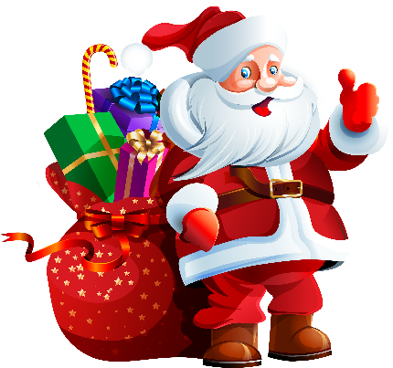


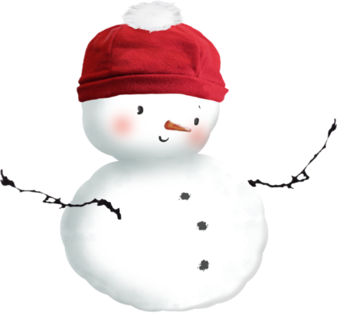

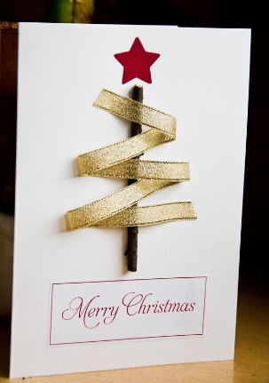
Have you decorated a Christmas tree?
Have you met Santa Claus?
Have you got lots of presents?
What are they?
Have you walked?
Have you skated?
Have you skied?
Have you made a snowman?
Have you written a Christmas card?

Slide 25
Where (you / spend) this summer?
Where have you spent this summer?
What (you / send) to your friend?
Where (he / be)?
What (you / know) about the USA?
Where (she / throw) her bag?

Slide 26
write
ride
make
meet
buy
wrote
rode
made
met
bought
written
ridden
made
met
bought

Slide 27
I (ride) _____________________ a bike in the summer.
He ( write) __________________ a Christmas postcard.
We (never ride) __________________________ a horse.
She ( not make) _________________ a big cake.
They (just meet) _____________________ Santa Clause.
Our parents ( buy) __________________ a lot of presents.
I (send) _________________________ a card for Joe.
He ( not meet) _____________________ Lizzy at the shop.
We (not buy) __________________ food for the party yet.
have ridden
has written
have never ridden
hasn’t made
have just met
have bought
have sent
hasn’t met
haven’t bought

Slide 28
I (ride) _____________________ a bike last summer.
He ( just find) ____________________ a present.
We (never ride) ________________________ an elephant.
She ( make) _________________ dinner yesterday.
They (already be) _____________________ in the USA.
We (meet) Madonna ________________when we were 5.
I (buy) _________________________ a present yesterday.
He ( not go) _____________________ to the shop yet.
I (know) __________________ Jane when I was young.
rode
has just found
have never ridden
made
have already been
met
have made
hasn’t gone
knew

