Slide 1


My Teacher Sees Right Through Me

Slide 2

I didn’t do my homework.

Slide 3

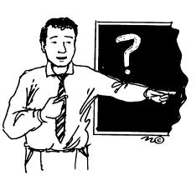
My teacher asked me “Why?”

Slide 4

I answered him , “It’s much too hard”

Slide 5

He said,
You didn’t try

Slide 6
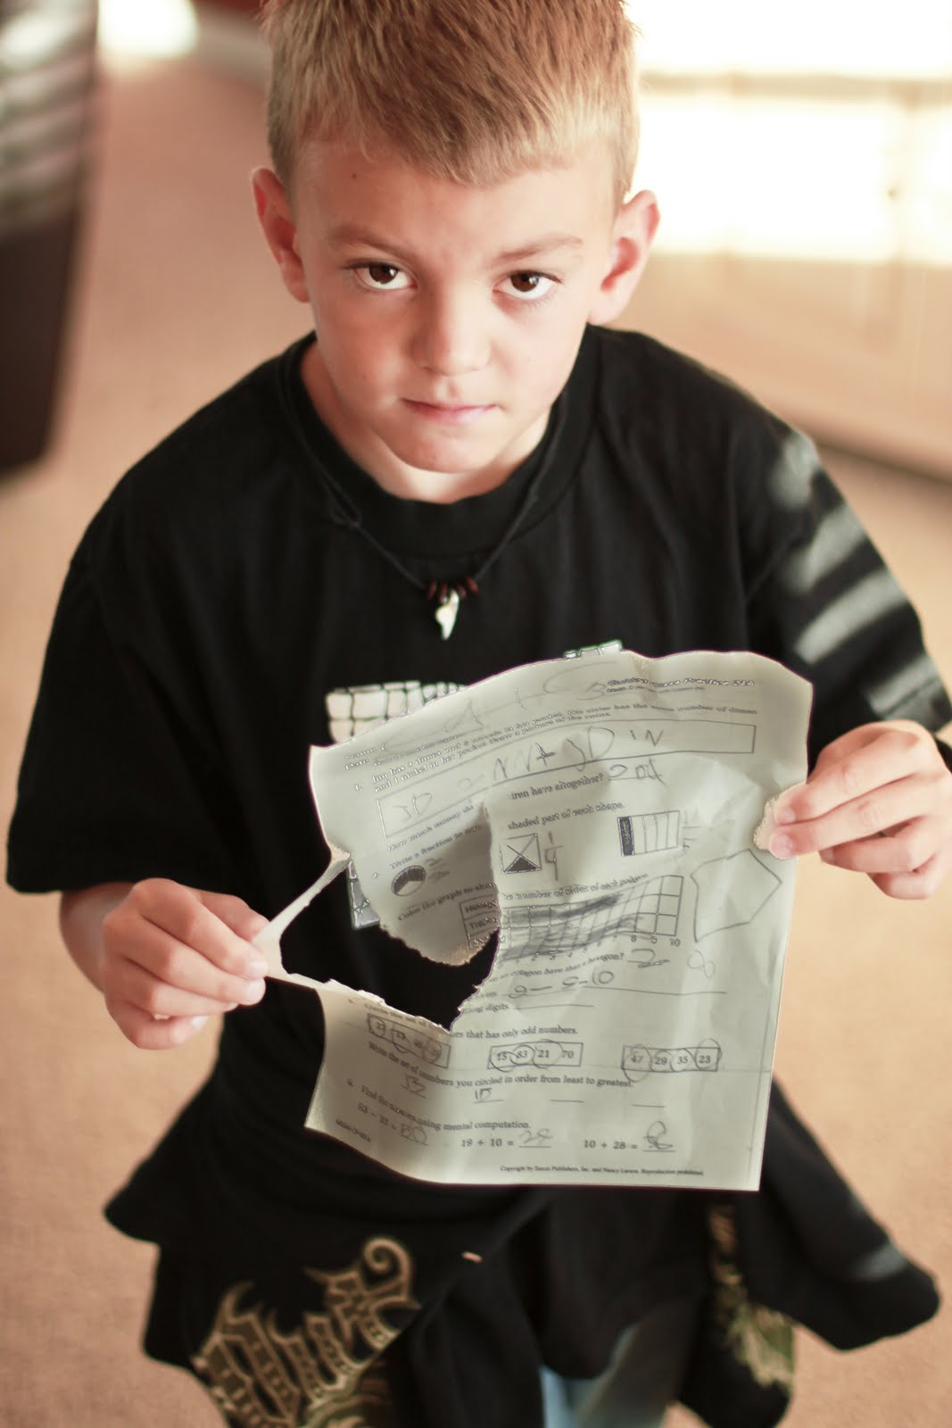
I told him, ”My dog ate it.”

Slide 7
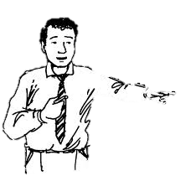
You have no dog.
He said

Slide 8
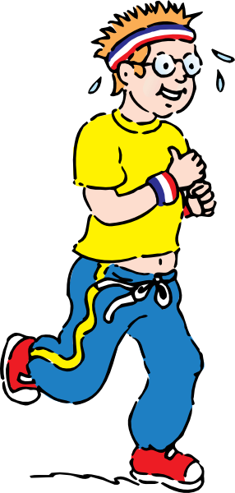
I said, ”I went out running.”

Slide 9
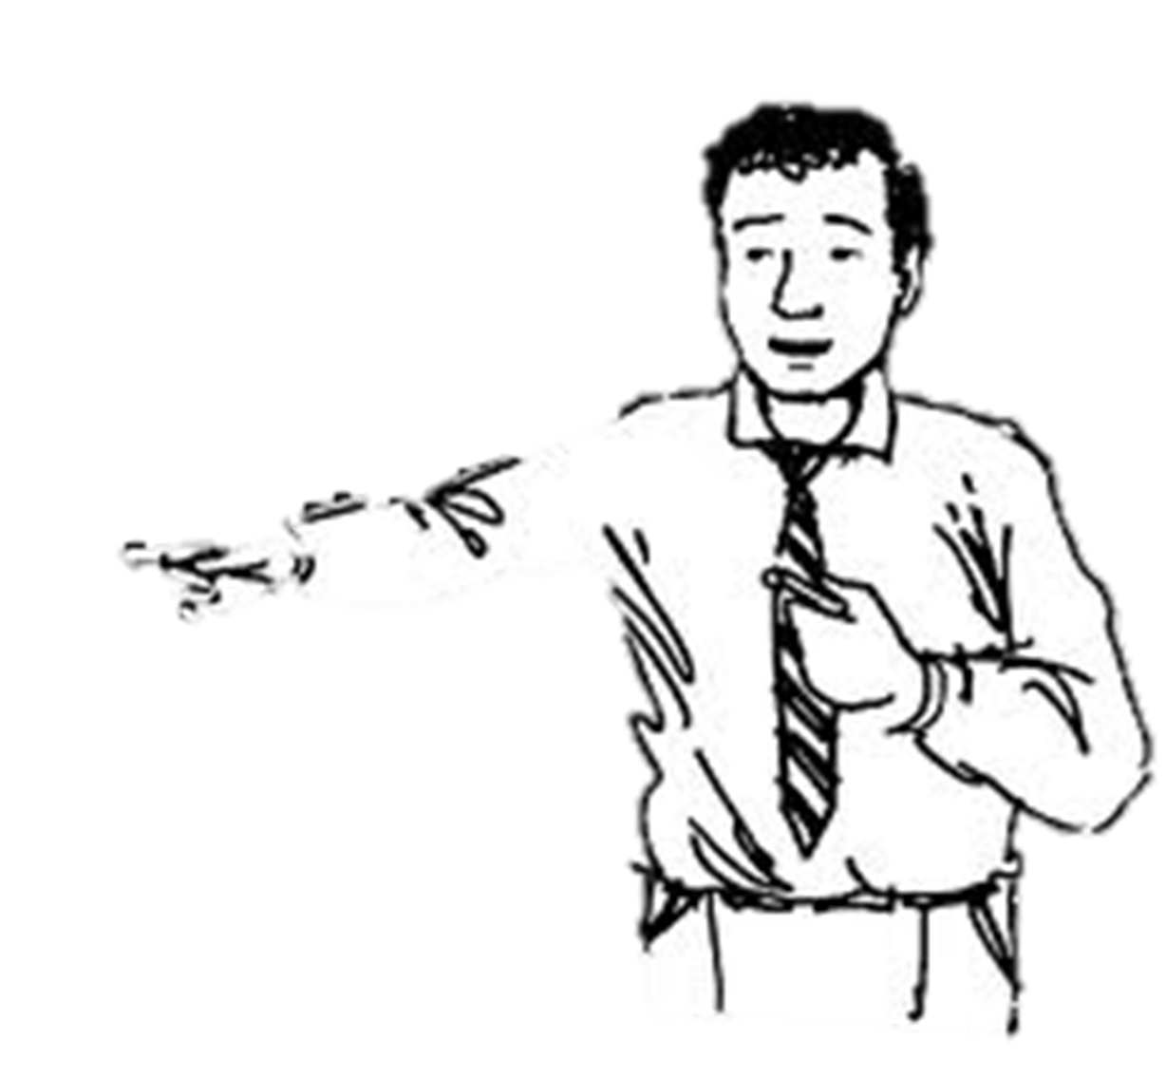
You never jog.
He said

Slide 10

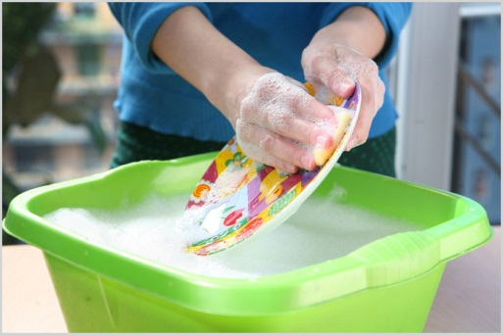
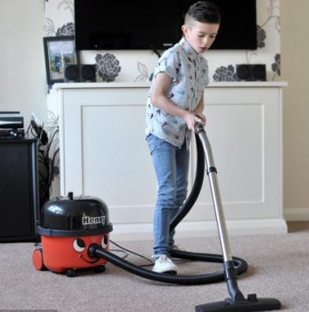
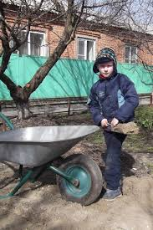
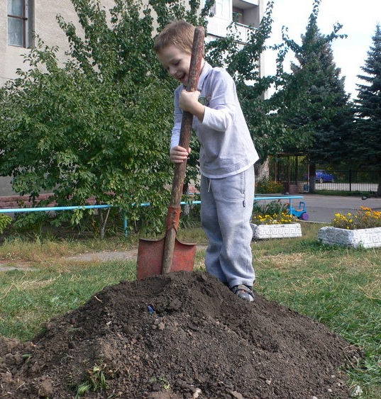
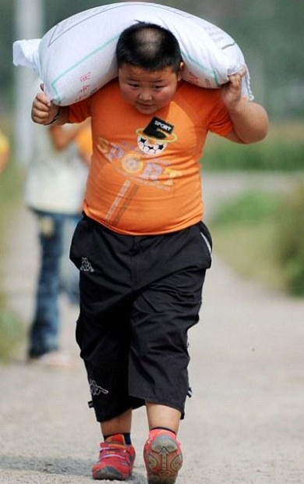
I told him “I had chores to do.”

Slide 11


He said, “You watched TV.”

Slide 12

I said, “I saw the doctor.”

Slide 13
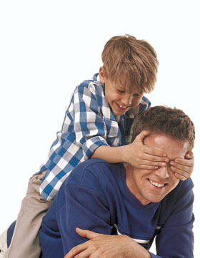


He said, “You were with me.”

Slide 14
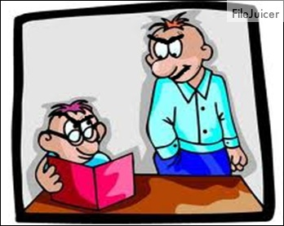

My teacher sees right through my fibs,

Slide 15

Which makes me very sad.

Slide 16
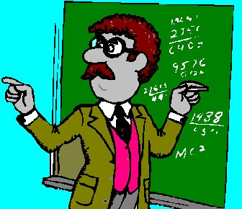
It’s hard to fool the teacher

Slide 17
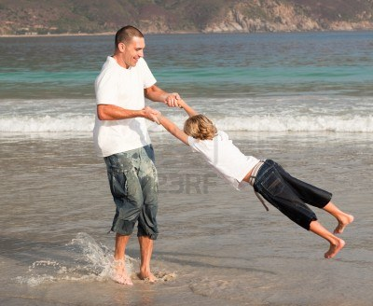

When the teacher is your dad.

