Slide 1
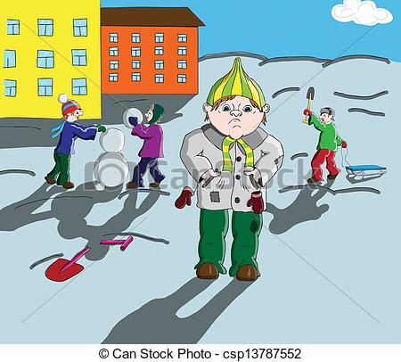
What does this child feel? Why?
They will not listen to me!
I have no hobbies!
They will think that I can’t be a good friend!
Which advice can you give him?

