Slide 1
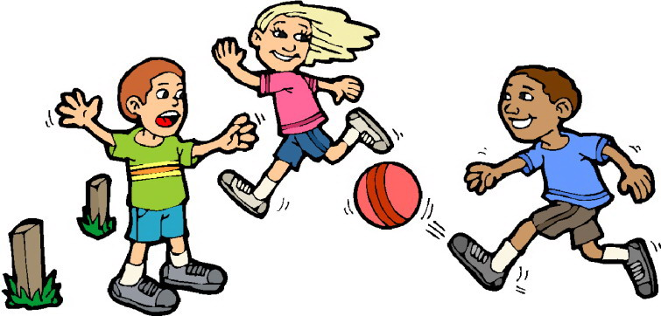

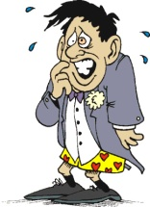
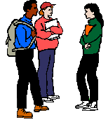






They are playing such an interesting game! Why am I sitting here? What am I waiting for?
All people feel when they first
, , ; to start a you need to

Slide 2

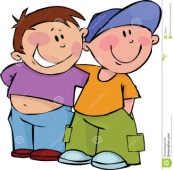










What should I do to break the ice?
1.
other people will
2. Get involved in and ;
3.
4. ; don’t talk about ;
5. being around other people because

