Slide 1
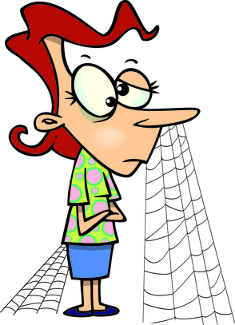

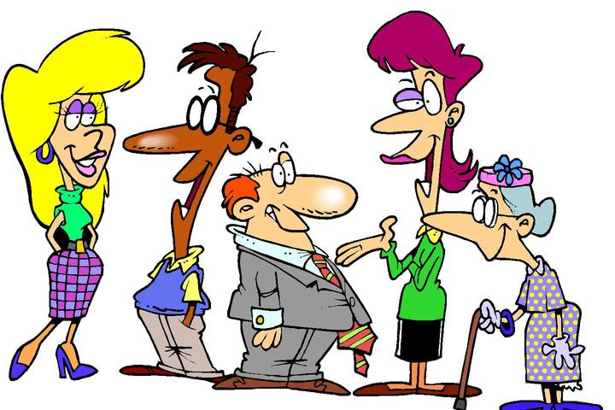
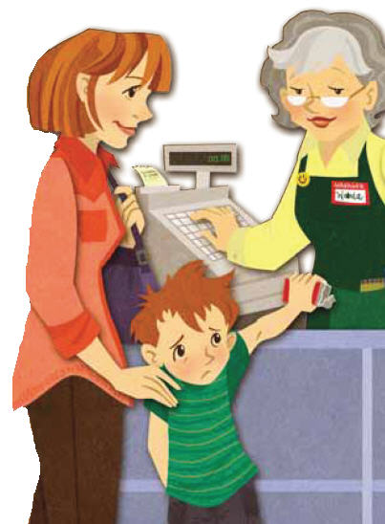

Characterise the people using the adjectives from ex. 5 p. 11:
I don’t want to go there! I will stay here forever!
I can wait for hours. I am never in a hurry.
I like meeting people and discussing the latest news!
Those children are playing such an interesting game… But will they want to play with me?
Sorry, I have stolen this bar of chocolate from your shop.

Slide 2
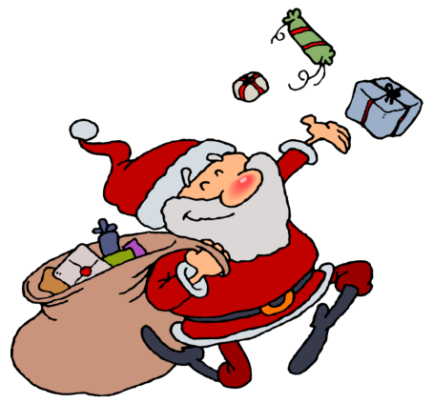

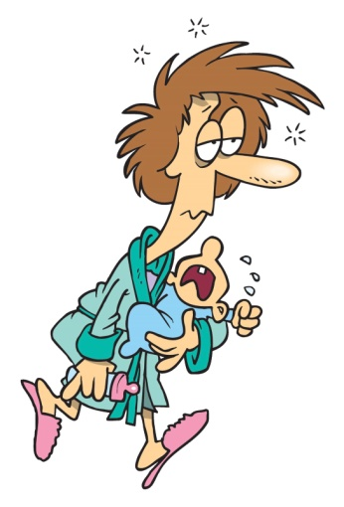
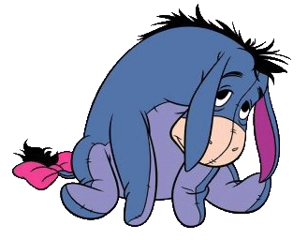

I am going to give a present to every child in this town!
I can’t wait for such a long time!
This terrible baby is crying all the time! He drives me crazy.
It’s my piece of cake! I am not going to share.
Everything is bad. Tomorrow everything will be even worse…

Slide 3
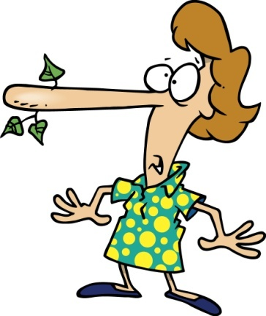
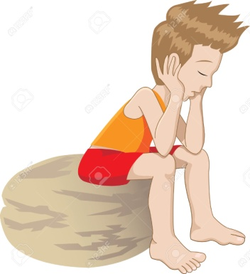

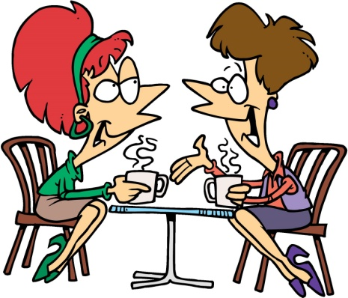
Characterise the people using the adjectives from ex. 6 p. 11:
I tell lies so often!
I want to be alone.
I am clever and handsome. Everything will be okay in my life.
Wow! We have a lot of time to discuss all the news.

