Slide 1
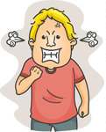
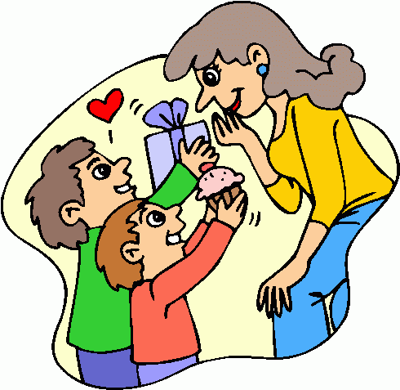
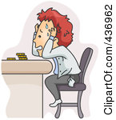

I will kill my boss!
I didn’t expect getting presents from you.
She says that she didn’t expect getting presents. What does she feel?
I think, she is surprised.
I can’t pay the bills.
Maybe I will go to the party, maybe not.

Slide 2
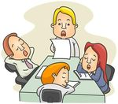

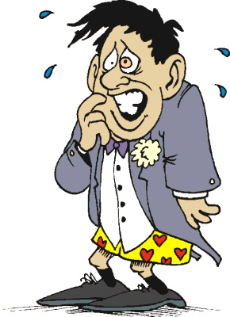
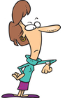
Our boss can’t tell us anything new.
I don’t know where to go.
says that ___________________. What does feel?
I think, is _______________.
I will not pass an exam.
I can’t wait for such a long time.

